Slide 1
Advanced Programming #1: Python Modules
CS Scholars – Programming

Slide 2
Learning Goals
Learn how to install and use external modules
Identify common popular modules for the Python language

Slide 3
Python Libraries
When you install Python on a machine, it comes with a large number of built-in libraries that provide functionality beyond the built-in syntax and functions. We've already introduced some: math, random, and tkinter.
However, there are many other libraries that have been built by developers outside of the core Python team, to add additional functionality to the language. These modules don't come as part of the Python language, but can be added in. We call these external modules.

Slide 4
Using External Modules

Slide 5
Finding Useful Modules
One of the main strengths of Python as a language is that there are thousands of external modules available, which means that you can start many projects based on work others have done instead of starting from scratch.
You can find a list of popular modules here: wiki.python.org/moin/UsefulModules
And a more complete list of pip-installable modules here: pypi.org

Slide 6
Install External Modules with pip
In order to use an external module, you must first install it on your machine. To install, you'll need to download the files from the internet to your computer, then integrate them with the main Python library so that the language knows where the module is located.
It is usually possible to install modules manually, but this process can be a major pain. Luckily, Python also gives us a streamlined approach for installing modules – the pip module! This feature can locate modules that are indexed in the Python Package Index (a list of commonly-used modules), download them, and attempt to install them.
Traditionally, programmers run pip from the terminal. This is a command interface that lets you make changes directly to your computer. But in this class, we'll just run pip in Pyzo.
Notes:
This means

Slide 7
Running pip
To run pip in Pyzo, use this command in the interpreter
pip install module-name
This will identify the module and your version of Python and start the download and installation process. It may run into a dependency error if the module needs a second module to already be installed – in general, installing that module and then running pip again will fix the problem.

Slide 8
Using an Installed Module
Once you've successfully installed a module, you should be able to put
import module-name
at the top of a Python file, and it will load the module the same way it would load a built-in library.
Note: this may fail if you have multiple versions of Python installed on your machine and you install in the terminal. Make sure to use the pip associated with the version of Python you're using in your editor. You can check your editor's version in Pyzo with Shell > Edit Shell Configurations (check the value in exe), then call pip using
pythonversion-number -m pip install module-name

Slide 9
Learning how a Module Works
Once a new module is installed, you're still left with one major question: how do you use it?
This varies by module, but the best answer is to read the documentation. Most external modules have official documentation or APIs that describe which functions exist and how to use the module.
It can also be helpful to search online for other projects that have used the same module, to find examples of how to set it up. Many people have written helpful tutorials online for this exact purpose.
Two standard resources for finding help are StackOverflow, a site where people can ask questions about code and get answers from other developers, and GitHub, a site where people post open-source projects for others to use and contribute to.

Slide 10
Reminder: always cite others' work!
You'll sometimes find a useful bit of code in a StackOverflow post or a GitHub project that you'll want to use in your own project.
Whenever you copy code from online, make sure to cite it the same way you would cite a paragraph of text in an essay. You can do this by putting a comment above the copied code that includes a link to the URL you got the code from.
This serves two purposes. First- it gives credit to the individual who originally wrote the code. Second- if you run into a problem with the code later on, you'll be able to look back to the original source to find a solution.
Note: policies around copying code change when you're working on a commercial product. Read the fine print if you're planning to sell your code!

Slide 11
Module Index
Math: NumPy, SciPy
Data Analysis: Matplotlib, pandas
Machine Learning: scikit-learn
Computer Vision: OpenCV
Natural Language Processing: nltk
Websites: Django, Flask
Webscraping: Beautiful Soup
Images: Pillow
Audio: Pydub
Game Design: Pygame
3D Graphics: VPython

Slide 12
Data Analysis
External Modules

Slide 13
SciPy Collection
SciPy is a group of modules that support advanced mathematical and scientific operations. It can handle large calculations that might take the default Python operations too long to compute.
The group includes NumPy (which focuses on core math), SciPy (math and science functions), pandas (data analysis), and Matplotlib (plotting of charts and graphs). These can be used separately or as a group. Each need to be installed separately, but can be installed directly with pip install name
Website: https://www.scipy.org/
Note: most of the SciPy Collection slides require knowledge of Python lists.
We'll learn about lists in Week 4.

Slide 14
NumPy
NumPy's main purpose is to support mathematical operations in Python.
That may not seem necessary at first, since Python already has support for many math operations in the built-in libraries, but NumPy has the advantage of being very efficient; that makes it a great library to use on large datasets.

Slide 15
NumPy Arrays
NumPy mostly works as you would expect for a Python library. Its main difference is that it organizes numbers in lists differently from regular Python.
NumPy creates special array objects of varying dimensions (like one- and two-dimensional lists); these arrays can represent vectors or matrices in mathematical calculation.
import numpy as np
np.array([10, 20, 30, 40])
# [10 20 30 40]
np.array([ [1, 2, 3], [4, 5, 6],
[7, 8, 9] ])
# [[1 2 3]
# [4 5 6]
# [7 8 9]]

Slide 16
NumPy Arrays – Operations
NumPy supports a lot more built-in operations on arrays that Python does on lists. For example, you can directly add a number to an array; that will add the number to each of the numbers inside the array.
You can also directly subtract one array from another; that will take the difference of the numbers at matching indexes.
import numpy as np
a = np.array([10, 20, 30, 40])
b = np.array([5, 6, 7, 8])
a + 2 # [ 12 22 32 42 ]
a - b # [ 5 14 23 32 ]

Slide 17
NumPy Arrays - Indexing
In addition to all of this, NumPy also supports more advanced indexing into multi-dimensional arrays.
For example, if you make a 2D array, you can index into it with row comma col instead of needing to use two indexes. This can be quite handy!
import numpy as np
c = np.array([ [1, 2, 3],
[4, 5, 6], [7, 8, 9]])
c[1, 2] # 6

Slide 18
NumPy Functions
NumPy does have its own set of mathematical functions- for example, it can generate random numbers.
x = numpy.random.randint(1, 10)
# random number in [1, 10]
However, it's mostly used as a support library for other libraries that want to use more efficient mathematical operations when doing statistics, or science, or engineering tasks.

Slide 19
SciPy
Next, let's look at the SciPy library. SciPy provides functions for scientific computation, mostly relying on NumPy for lower-level calculations.
The SciPy functions tend to be a bit higher-level so that you can run whole processes automatically instead of scripting them yourself.
SciPy also splits its functions into different sub-libraries. For example, there's a sub-library called linalg for linear algebra, one called signal for signal processing, and one called stats for statistics.

Slide 20
SciPy Functions
SciPy isn't too hard to use when you have a specific purpose in mind. Just find the sub-library that corresponds to what you want to do, set up your data properly, and run the function.
For example, if you want to find the inverse of a matrix (where your matrix times its inverse equals the identity matrix), there's a function for that!
Just import the linalg sub-library, set up your matrix as a NumPy two-dimensional array, then run linalg.inv.
import numpy as np
from scipy import linalg
a = np.array([ [ 1, 2 ], [3, 4] ])
linalg.inv(a))
# [[-2. 1. ]
# [ 1.5 -0.5]]

Slide 21
Matplotlib
The matplotlib library can be used to generate interesting visualizations in Python. This is great for data analysis!
The way that specific types of charts and graphs are set up can vary a lot, but there are some core components to every chart that are consistent.

Slide 22
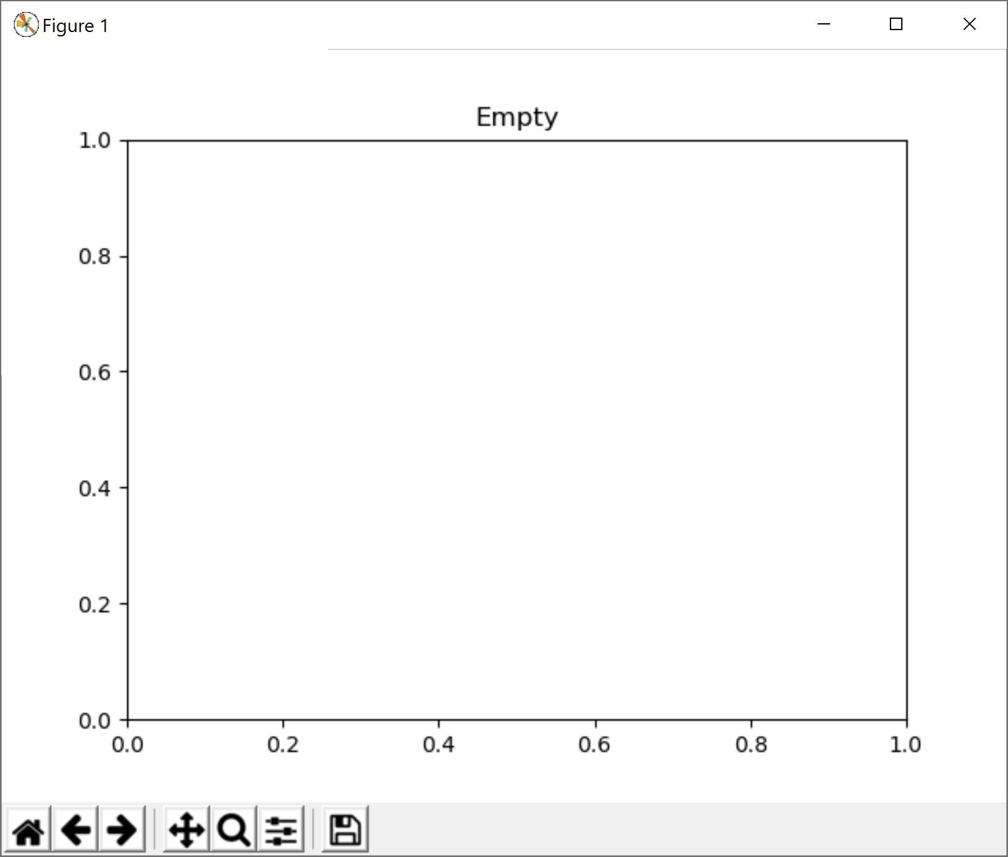
Draw Visualizations on the Plot
Matplotlib visualizations can be broken down into several components. We'll mainly care about one: the plot (called plt). This is like Tkinter's canvas, except that we'll draw visualizations on it instead of shapes.
We can construct an (almost) empty plot with the following code. Note that matplotlib comes with built-in buttons that let you zoom, move data around, and save images.
import matplotlib.pyplot as plt
plt.title("Empty")
plt.show()

Slide 23
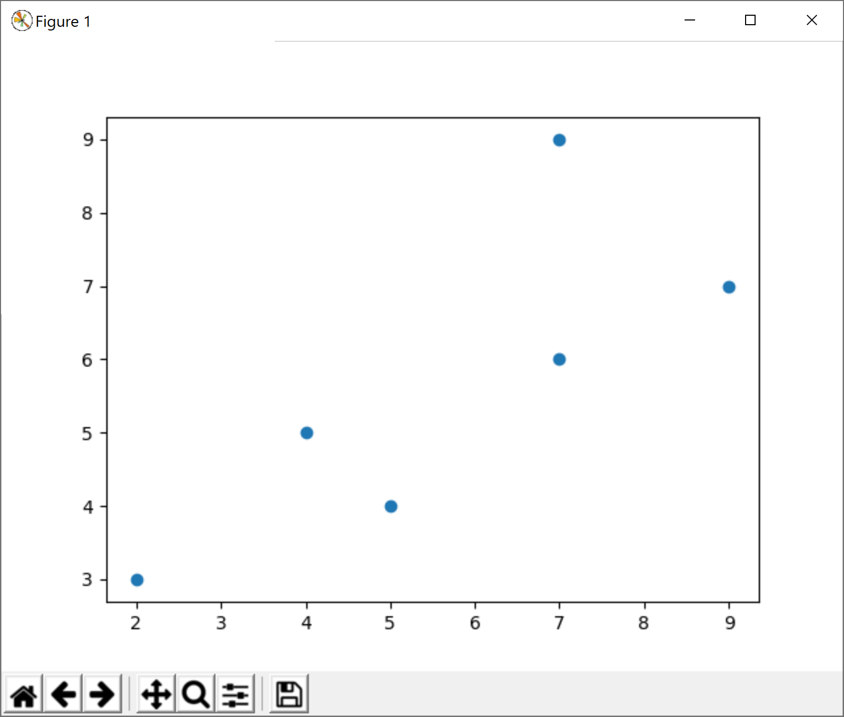
Add Visualizations with Methods
There are lots of built-in methods that let you construct different types of visualizations. For example, to make a scatterplot use plt.scatter(xValues, yValues).
x = [2, 4, 5, 7, 7, 9]
y = [3, 5, 4, 6, 9, 7]
plt.scatter(x, y)
plt.show()

Slide 24
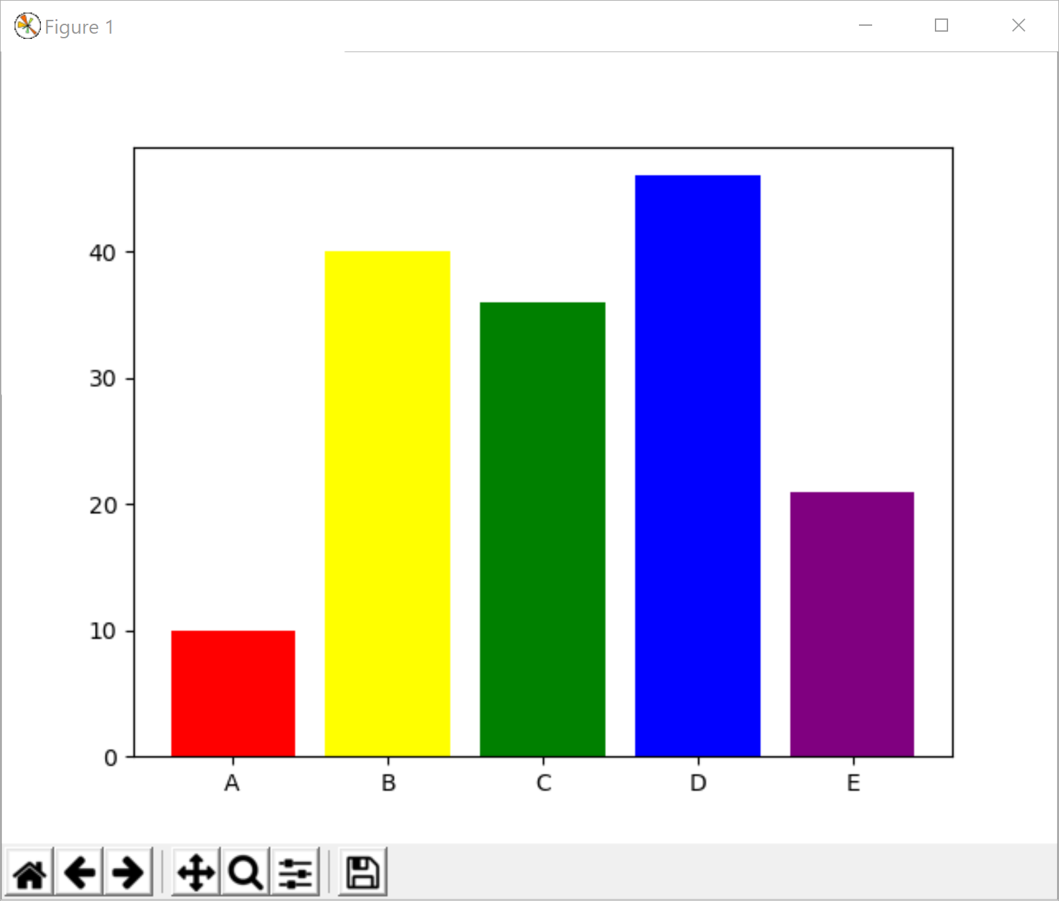
Visualization Methods have Keyword Args
You can customize how a visualization looks by adding keyword arguments. We used these in Tkinter to optionally change a shape's color or outline; in Matplotlib we can use them to add labels, error bars, and more.
For example, we might want to create a bar chart (with plt.bar) with a unique color for each bar. Use the keyword argument color to set the colors.
labels = [ "A", "B", "C", "D", "E" ]
yValues = [ 10, 40, 36, 46, 21 ]
colors = [ "red", "yellow", "green",
"blue", "purple" ]
plt.bar(labels, yValues, color=colors)
plt.show()

Slide 25
Matplotlib Approaches
If you browse the Matplotlib website, you'll see that charts can be drawn with one of two different approaches - object oriented or procedural.
The object-oriented approach lets you break down the window into objects, then control each object independently. Charts are drawn by calling methods on appropriate objects. We'll talk more about object-oriented coding in future advanced slides.
The procedural approach instead has you call all functions from one central library, matplotlib.pyplot, which is usually aliased to plt. Charts are drawn by calling functions to set up all the elements you want.
Either approach is generally fine- just pick one and stick with it.

Slide 26
Fig and Ax
Here's a quick thing to know if you're using the object-oriented approach. Every graph is drawn in a figure, which has some number of axes. A figure is like a window that pops up on your screen; an axis is a part of that window dedicated to one specific visualization.
To interact with the figure and axis directly, call plt.subplots to access the two objects. This function returns two objects, so you should set up two variables to capture the results. This can be done easily with fig, ax = plt.subplots().
import matplotlib.pyplot as plt
fig, ax = plt.subplots()

Slide 27
Pandas
Pandas is specifically built to support data analysis for data in spreadsheets, or tables. It's great for Excel-style coding.
Pandas mostly works on a kind of data structure called a DataFrame, which is basically a spreadsheet table.

Slide 28
Pandas DataFrames
DataFrames act a bit like 2D lists, except that it's as easy to access data by column as it is to access data by row.
You can set up a DataFrame directly from a 2D list fairly easily, as is shown here.
Note that, like in NumPy arrays, the DataFrame is displayed a little differently- there are no commas between values, and the row and column indexes are included directly.
import pandas as pd
df = pd.DataFrame([ [1, 2, 3],
[4, 5, 6] ])
df
# 0 1 2
# 0 1 2 3
# 1 4 5 6

Slide 29
Pandas DataFrame Columns
Where DataFrames get really interesting is that you don't need to refer to columns by index.
You can give them names instead, just like you often would in a spreadsheet with a header!
We can do this by adding a keyword argument, columns, with a list of column names.
import pandas as pd
df = pd.DataFrame([ ["15-110", "Principles of Computing", 10],
["15-112", "Fundamentals of Programming and CS", 12],
["15-251", "Great Ideas in Theoretical CS", 12] ],
columns=["Course Number", "Course Name", "# Units"])
df
# Course Number Course Name # Units
# 0 15-110 Principles of Computing 10
# 1 15-112 Fundamentals of Programming and Computer Science 12
# 2 15-251 Great Ideas in Theoretical Computer Science 12

Slide 30
Pandas DataFrame Indexing
Once you have a DataFrame set up, you can index into it by column with a normal index operation, just by providing the column name.
For example, if we index by "Course Number" in the DataFrame we've created here, we'll get the values in that column of the table.
Note that when the values are displayed, they're paired with their row indexes, and the column name and type are shown at the bottom. Handy!
import pandas as pd
df = pd.DataFrame([ ["15-110", "Principles of Computing", 10],
["15-112", "Fundamentals of Programming and CS", 12],
["15-251", "Great Ideas in Theoretical CS", 12] ],
columns=["Course Number", "Course Name", "# Units"])
df["Course Number"]
# 0 15-110
# 1 15-112
# 2 15-251
# Name: Course Number, dtype: object

Slide 31
Pandas Functions
Outside of DataFrames, the pandas library works about the way you'd expect. You can call methods on DataFrames to analyze the data in them or modify the table as needed.
For example, if we want to get the median number of units of all the courses in the dataset, we just need to index into the # Units column, then call the median() method on that set of data values.
import pandas as pd
df = pd.DataFrame([ ["15-110", "Principles of Computing", 10],
["15-112", "Fundamentals of Programming and CS", 12],
["15-251", "Great Ideas in Theoretical CS", 12] ],
columns=["Course Number", "Course Name", "# Units"])
df["# Units"].median()
# 12.0

Slide 32
Machine Learning
External Modules

Slide 33
Machine Learning Overview
Machine learning is the process of algorithmically finding patterns in a dataset, so that a machine can answer questions about new data or group similar pieces of data together.
There are many, many different algorithms that have been designed to support machine learning. Most machine learning libraries implement those algorithms for you; all you need to do is decide which algorithm is the best fit for your data
For general machine learning, we'll recommend scikit-learn. For specialized algorithms, we'll discuss OpenCV and nltk.

Slide 34
scikit-learn
scikit-learn is a module that supports a large set of machine learning algorithms in Python. If you want to dabble in machine learning or artificial intelligence, this is a good place to start. Note that you'll still need to provide a starting dataset to get any algorithm to work.
Website: https://scikit-learn.org/stable/
Install:
pip install scikit-learn

Slide 35
Understanding Algorithms
Running algorithms with scikit-learn isn't too hard; you just call methods on your data to set up a model and then use the model to make predictions or check results as needed.
The harder part of machine learning is understanding how the algorithms work, and knowing which algorithm to use for any given task.
There's no shortcut for this; you just have to do a lot of learning to get familiar with lots of different possible approaches.
We'll cover machine learning in the advanced slides for Week 5, and we'll talk more about how to choose the proper algorithm there.

Slide 36
scikit-learn Demo
Let's just look at one example to see what the general process looks like.
I've got a grade dataset - five quiz grades and a final exam grade for a set of 145 students - and I want to cluster the data points, to see which groups naturally emerge.
I'll use a clustering algorithm for this, and I'll specifically choose to use K-means clustering.

Slide 37
Loading Data from a File
We'll go over how to load data from files later in the program (in Week 4). For now, we'll just use the built-in csv library to load a spreadsheet into a 2D list.
import csv
f = open("grades.csv", "r")
reader = csv.reader(f)
data = list(reader)
f.close()

Slide 38
Running the Algorithm
Next, we need to create a model based on the data.
We'll run the KMeans algorithm and tell it to create three clusters. Then we'll fit that model to the dataset. The resulting model is an object with certain properties.
from sklearn.cluster import KMeans
model = KMeans(n_clusters=3).fit(data)

Slide 39
scikit-learn Model Properties
For example, you can check what the average scores of the three clusters are by looking at the cluster_centers_ property. The first five numbers are quiz scores, and the last is a final exam score.
model.cluster_centers_
# [[89.4271 94.4223 91.5873 95.2281 91.7184 87.7427]
# [61.7857 81.7857 48.9285 80.6428 66.4285 63.5 ]
# [87.1 89.7 66.2857 90.6285 90.7142 79. ]]

Slide 40
scikit-learn Model Properties
How many students are in each cluster? You can check that by looking at the labels_ property. This shows which cluster label was assigned to each data point. By turning the labels list into a list and running the count method, you can check how many students are in each group.
model.labels_
# [0 2 0 0 0 2 0 2 0 2 0 0 2 2 0 0 0 0 2 2 0 0 0 0 0 0 0 2 2 0 0 2 2 2 1 2 0
# 0 0 0 2 2 0 0 2 0 0 1 2 0 0 0 2 0 0 0 0 0 1 0 2 0 0 0 0 0 2 0 0 0 0 1 0 2
# 0 0 1 0 0 0 0 0 0 0 0 0 1 0 0 2 0 0 0 0 0 2 0 0 2 2 0 0 0 0 0 0 0 0 2 0 0
# 0 0 0 0 2 0 0 0 0 2 0 0 0 0 2 2 1 0 2 2 0 0 2 0 0 0 0 0 0 0 2 0 0 0]
L = list(model.labels_)
L.count(0) # 103
L.count(1) # 7
L.count(2) # 35

Slide 41
scikit-learn Model Functions
Finally, if you want to use this model to put a new data point into one of the clusters, use the predict method.
Predict takes a list of data points, so put the single data point in another list. The result is the cluster that the student is assigned to.
student = [60, 70, 75, 80, 85, 87]
model.predict([student]) # [2]

Slide 42
OpenCV
The OpenCV library is a good choice if you want to do machine learning with images. CV in this case stands for computer vision.
You can install it under the name opencv-python, then import it with the name cv2. Usually this gets aliased to cv.
pip install opencv-python
import cv2 as cv

Slide 43
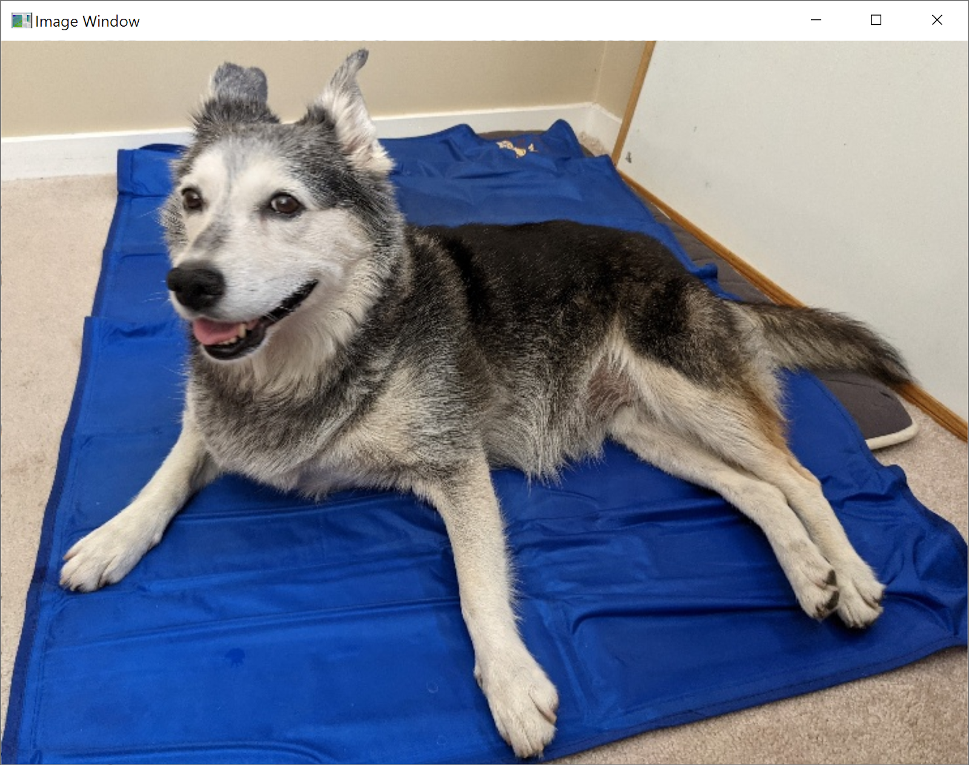
OpenCV Example
OpenCV lets you load images and recognize features in them, like lines, or corners, or digits.
For example, let's say I want to detect edges in an image. First, I can load an image with imread.
I can check that image with imshow too if I want to! But I have to set up a line of code afterwards so that the program knows to keep the window open and close it when you press x.
import cv2 as cv
img = cv.imread("dog.jpg")
cv.imshow("Image Window", img)
k = cv.waitKey(0)

Slide 44
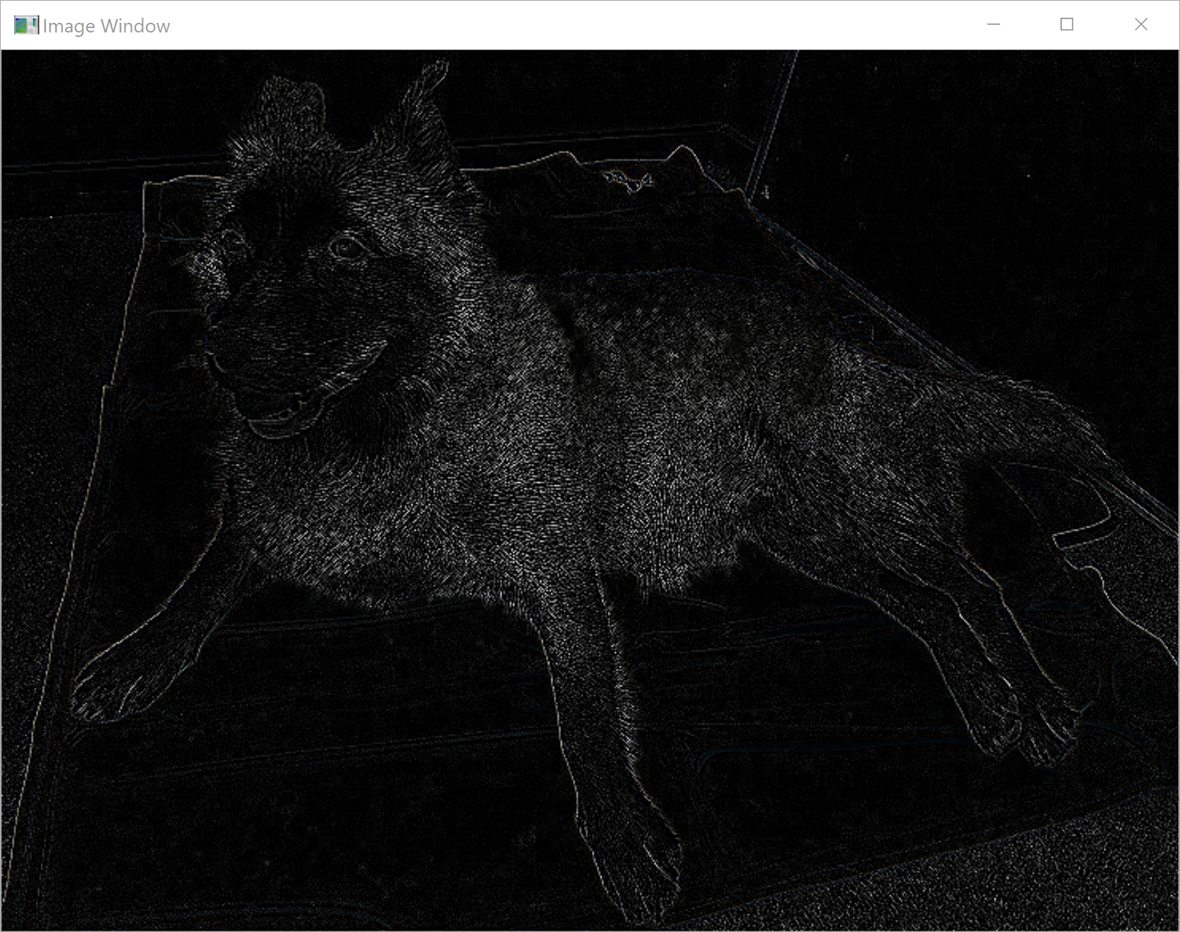
OpenCV Example
To detect lines in the image, I need to call a method on the image object. I'll use a Laplacian algorithm and set the depth threshold fairly low.
Now we can see that the algorithm automatically detected edges around the dog, and the mat she was laying on. Pretty cool!
Being able to detect these kinds of features makes it easier to run images through machine learning algorithms.
import cv2 as cv
img = cv.imread("dog.jpg")
lines = cv.Laplacian(img, cv.CV_8U)
cv.imshow("Image Window", lines)
k = cv.waitKey(0)

Slide 45
nltk
nltk, the Natural Language Toolkit, assists with natural language processing for machine learning purposes. This is useful whenever you're working with a corpus of written texts.
Website: https://www.nltk.org/
Install:
pip install nltk

Slide 46
nltk Functions
One handy thing you can do with nltk is to tokenize text. This takes a sentence and breaks it up into words.
Note that this doesn't just split up the string by spaces- it intelligently breaks up words based on punctuation as well.
import nltk
text = '"My heart is in the work!" Andrew said.'
nltk.word_tokenize(text)
# ['``', 'My', 'heart',
'is', 'in', 'the',
'work', '!', "''",
'Andrew', 'said', '.']

Slide 47
nltk Functions
You can also do sentiment analysis with nltk, where you build a model to detect whether a piece of text is generally positive, negative, or neutral based on the words in contains.
You can train your own model, but you can also use a pre-built model by importing the SentimentIntensityAnalyzer, which is in the sub-library sentiment.
Then you can just call the method polarity_scores on the text you want to score to see what the model thinks!
import nltk.sentiment
analyzer = nltk.sentiment.SentimentIntensityAnalyzer()
analyzer.polarity_scores('"My heart is in the work!" Andrew said.')
# {'neg': 0.0, 'neu': 1.0, 'pos': 0.0, 'compound': 0.0}
analyzer.polarity_scores("Today is such a beautiful day!")
# {'neg': 0.0, 'neu': 0.488, 'pos': 0.512, 'compound': 0.636}
analyzer.polarity_scores("I'm in a bad mood. Go away.")
# {'neg': 0.412, 'neu': 0.588, 'pos': 0.0, 'compound': -0.5423}

Slide 48
Web Development
External Modules

Slide 49
Regular Web Design
If you want to build a simple website- something that will just display some text and images, perhaps - you should stick to the core languages of website design, HTML for content structure and CSS for styling.
And if you just want to program in a little interactivity, the language Javascript is easy to integrate with HTML and CSS, and is commonly paired with those languages.
But if you want to build a more complex website that keeps track of user state and saves data, Python can help you out!

Slide 50
Django
Django is a module that lets you build interactive websites using Python. This involves setting up a frontend (the part of a website that the user sees while browsing) and a backend (the part of a website that processes requests and does the actual work).
Website: https://www.djangoproject.com/
Install:
pip install django

Slide 51
Django Principles
The core principles behind Django are that it is object-oriented and it uses databases extensively.
Django uses objects to represent the data tracked by a website. For example, a User object might have properties like username, and password, and items in a shopping cart.
A database is a data structure that's based on a table. Databases are designed to be able to hold a lot of data and to make it easy to look up data based on specific properties.

Slide 52
Programming with Django
Programming websites in Django is pretty complicated. You should learn about functions, dictionaries, and object-oriented programming before attempting it.
Once you're ready, you can work through a tutorial of how to set up a Django website here:
https://docs.djangoproject.com/en/3.2/intro/tutorial01/

Slide 53
Flask
Flask is also a module that lets you build interactive websites using Python. But Flask starts with a simple, lightweight website, instead of requiring you to set up a database and objects first.
Website: https://flask.palletsprojects.com/
Install:
pip install flask

Slide 54
Programming in Flask
You can set up a simple website in Flask pretty easily, just by using a function and some advanced Python syntax.
import flask
app = flask.Flask("Example")
@app.route("/")
def tutorial():
return "<p>My Website</p>"
But if you want to make more advanced websites, you'll still need to learn some complex Python syntax first.

Slide 55
Beautiful Soup
Beautiful Soup is a module that supports webscraping and HTML parsing. This is useful if you want to gather data from online for use in an application.
Website: https://www.crummy.com/software/BeautifulSoup/
Install:
pip install beautifulsoup4

Slide 56
Parse HTML as Tags
HTML organizes content on a page using tags, like this:
<tag attribute="value">
<subtag> Some content for the subtag </subtag>
</tag>
To parse a website, you need to look for a certain type of tag in the file.

Slide 57
Load HTML with urllib
First, how can you get the HTML of a website?
There's a handy built-in library for that, urllib. It doesn't work in all cases (like when authentication is required), but it works for basic websites.
from bs4 import BeautifulSoup
import urllib.request
page = urllib.request.urlopen("https://docs.python.org/3/")
text = page.read()
doc = BeautifulSoup(text, 'html.parser')

Slide 58
BeautifulSoup Navigation
You can access the content of a BeautifulSoup page with tag names.
For example, at the top level of the whole document, request the title of the page by accessing the property title, with a period between the variable and the property. Or access the whole body of the page with the property body.
doc = BeautifulSoup(text, 'html.parser')
doc.title # <title>3.9.6 Documentation</title>
doc.body # <body><div aria-label="related navigation" ...

Slide 59
More BeautifulSoup Navigation
Sometimes tags will have other tags inside them. When this happens, you can continue accessing specific tags at each level.
doc.body.p # <p>Welcome! This is the documentation for Python ...
For example, to get the first paragraph tag in the body, use doc.body.p.
If you want to get the text within that tag, just use the string property.
doc.body.p.string # '\n Welcome! This is the documentation for ...

Slide 60
BeautifulSoup Functions
Note: this and the next slide use lists, dictionary indexes, and loops
To get all the tags of a certain type in the document, instead of just the first tag of that type, use the method find_all on the document. This produces a list of all the tags of that type.
a_tags = doc.find_all('a')
a_tags
# [ <a accesskey="I" href="genindex.html" title="General Index">index</a>,
# <a href="py-modindex.html" title="Python Module Index">modules</a>,
# <a href="https://www.python.org/">Python</a>,
# <a href="#">3.9.6 Documentation</a>,
# ... ]

Slide 61
BeautifulSoup Attributes
Note that some of those a tags had properties. You can access the property of a tag with a dictionary index.
a_tags[0]["href"]
# "genindex.html"
So if I wanted to get all the links on a webpage, I could use this:
for tag in a_tags:
print(tag["href"])
# genindex.html
# py-modindex.html
# https://www.python.org/
# ...

Slide 62
Creative External Modules

Slide 63
Pillow: Python Imaging Library
Pillow is a lightweight and easy-to-install module that lets you manipulate images beyond .gif files. It lets you modify images, or use different types of images in Tkinter.
Website: https://pillow.readthedocs.io/en/stable/index.html
Install:
pip install pillow
Import:
import PIL

Slide 64

Pillow Images
Pillow makes it very easy to open image files, using the Image.open function. You can even display those images with image.show(), or save them with image.save()
from PIL import Image
img = Image.open("stella.jpg")
img.show()
img.save("new-stella.jpg")

Slide 65



Pillow Image Functions
You can provide Pillow images to the Tkinter create_image function, but you can also manipulate them directly!
There are functions that let you crop and resize pictures within the program, and much more! However, some of these functions require that you use lists to hold the dimensions of the picture.
new_img = img.crop([200, 200, 3500, 2500])
new_img.save("new-stella.jpg")
new_img_2 = img.rotate(180)
new_img_2.save("new-stella-2.jpg")
new_img_3 = img.resize([1000, 1000])
new_img_3.save("new-stella-3.jpg")

Slide 66
Pydub
Pydub makes it possible to play and edit audio files! However, it needs a few additional libraries to work really robustly. First, you'll need to install the library simpleaudio to play the edited sounds.
Website: https://github.com/jiaaro/pydub
Install:
pip install simpleaudio
pip install pydub

Slide 67
Pydub AudioSegments
Pydub lets you load a sound file into an AudioSegment object. It's then really easy to play the sounds and edit them!
Unfortunately, by default the library only supports .wav files. It's possible to get the library to work on more popular filetypes (like .mp3 files), but requires a lot of complicated installations.
First, let's just look at a simple example with a .wav file. Note that once the file starts playing, it will continue until the song ends; you'll need to interrupt the program by pressing the lightning bolt button if you want to stop it early.
from pydub import AudioSegment
from pydub import playback
music = AudioSegment.from_wav('song.wav')
playback.play(music)

Slide 68
Pydub AudioSegment Editing
To edit music with pydub, you use slicing, like how you edit strings and lists.
The AudioSegment represents the song in millisecond segments. So to get the first second of a song, you'd use:
song[:1000] # first second
Or to get only the first half of a song, you'd use:
song[:len(song)//2] # first half

Slide 69
Pydub AudioSegment Editing
You can also change the volume of a song by adding or subtracting decibels from it.
This works like NumPy arrays – you can add or subtract a single number from the segment, and it will propagate across all the values.
song – 20 # make quieter

Slide 70
Pydub AudioSegment Functions
There are a bunch of cool functions already implemented for you. For example, you can implement fading, or speed up a song or remove silence.
Note that these functions may take a little while to run- be patient! You can always save the result in a new file, then play that file directly.
music = music.fade_in(10*1000)
music = music.speedup(2)
music = music.strip_silence()
music.export("new_song.wav", format="wav")

Slide 71
Pydub and MP3 Files
If you want to edit more popular music file formats (like mp3 files), you've got two options.
One: try to install ffmpeg, a non-python library that supports a wide range of audio formats. Unfortunately, you can't do this with pip. Here's instructions from Pydub on how to install: https://github.com/jiaaro/pydub#getting-ffmpeg-set-up
Two: convert your MP3 file into a WAV file using a different audio application. One option is VLC, which is available for free. You can convert files by going to Media > Convert/Save, but you'll need to set up a new profile format for WAV. Here's instructions for how to do that: https://promincproductions.com/blog/export-wav-audio-file-from-any-video-clip-with-vlc/

Slide 72
Pygame
Pygame is, like Tkinter, a library that lets you make graphical applications. However, Pygame is specifically designed to create games. It has better support for sprites and collision detection than tkinter.
Website: https://www.pygame.org/news
Install:
pip install pygame

Slide 73
Pygame Essentials
The core difference between coding a game versus other kinds of coding is that the game needs to be interactive, which means that it needs to keep running continuously while waiting for input from the user.
Pygame supports this through a game loop. This is just a while loop that loops until you tell it to stop. (We'll cover loops in Week 3 of the class).
Inside that loop, the game constantly checks for input from the user, responds to any inputs it has received, and generally keeps the game moving.

Slide 74
Pygame Window
Let's say we want to open up a simple window. We can do that with the set_mode method, but that by itself isn't enough.
We also want to be able to close that window by pressing the x button. So we need to constantly check whether the user has asked to quit inside the game loop.
We can do this by checking all the events that were received by the game system. When a QUIT event happens, exit the loop, then call the built-in function exit() to exit the window as well.
import pygame
pygame.init()
playing = True
width, height = 500, 500
screen = pygame.display.set_mode([width, height])
while playing:
for event in pygame.event.get():
if event.type == pygame.QUIT:
playing = False
exit()

Slide 75
Pygame Demo
This isn't a game yet, though- it's just a window.
Let's make a simple clicker game. The user can click on an image on the screen; whenever they do, their score goes up by one.
This demo will go over some of the core components of Pygame, but there's a lot more it doesn't cover! You can do quite a bit with this library.

Slide 76
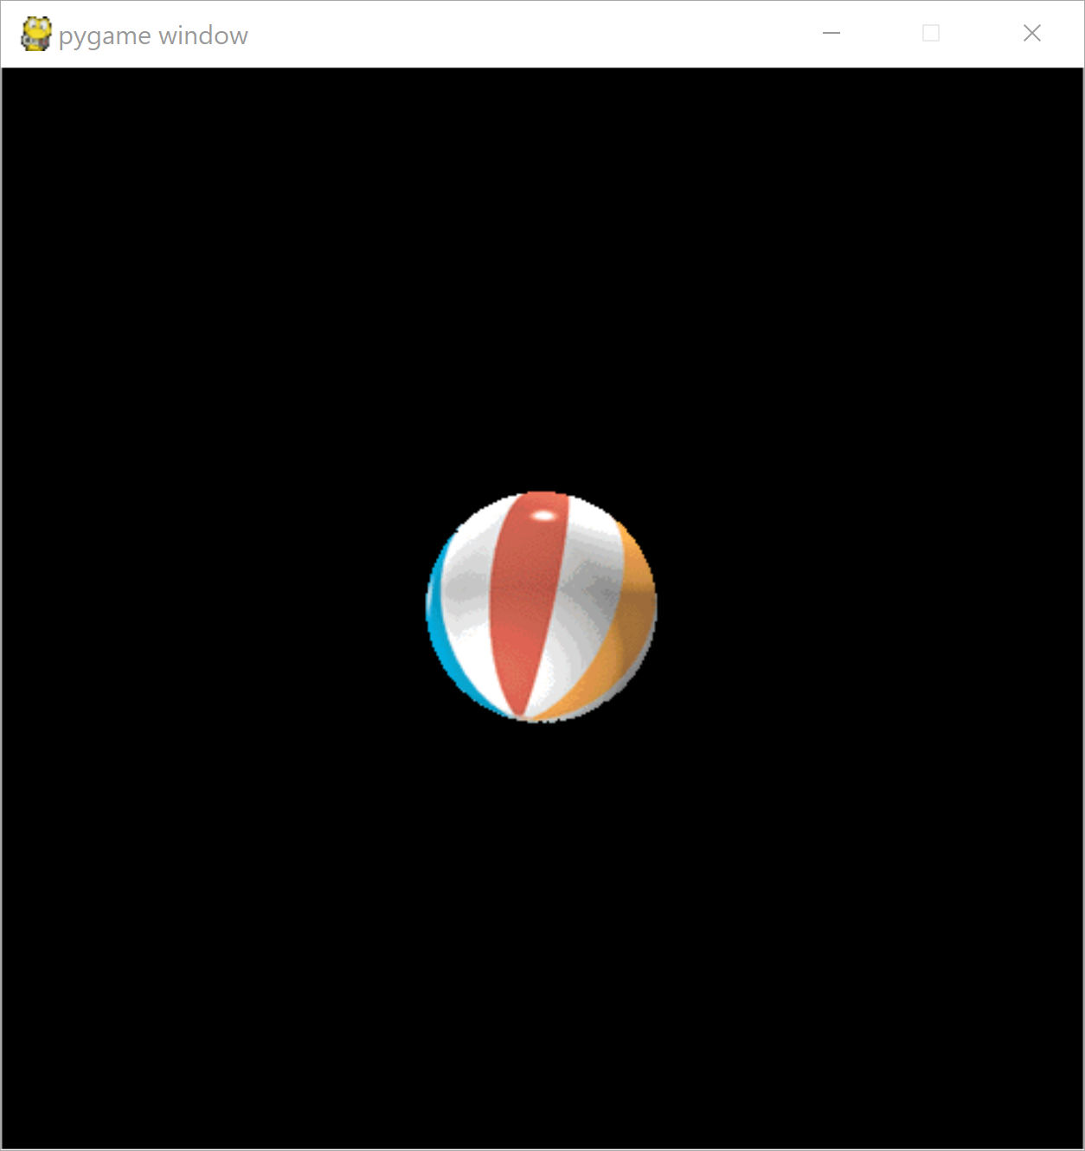
Pygame Images
The tricky thing here is that Python needs to refresh the window every time the game loop runs, just in case something changes. So you should actually draw the image inside the game loop.
However, you only want the image to show up once. Before you draw anything, fill the background of the screen with a solid color using screen.fill, to erase anything drawn before.
First, load the image using the pygame.image.load method. Then set up a rectangle that corresponds to the image in the position where you want to show up. Use get_width and get_height on the image to make sure it is centered. Finally, use screen.blit to actually draw the image in the game loop.
import pygame
pygame.init()
playing = True
black = pygame.Color(0, 0, 0)
width, height = 500, 500
screen = pygame.display.set_mode([width, height])
icon = pygame.image.load("ball.gif")
icon_rect = pygame.Rect(250 - icon.get_width()/2,
250 - icon.get_height()/2,
250 + icon.get_width()/2,
250 + icon.get_height()/2)
while playing:
for event in pygame.event.get():
if event.type == pygame.QUIT:
playing = False
screen.fill(black)
screen.blit(icon, icon_rect)
pygame.display.flip()
exit()

Slide 77
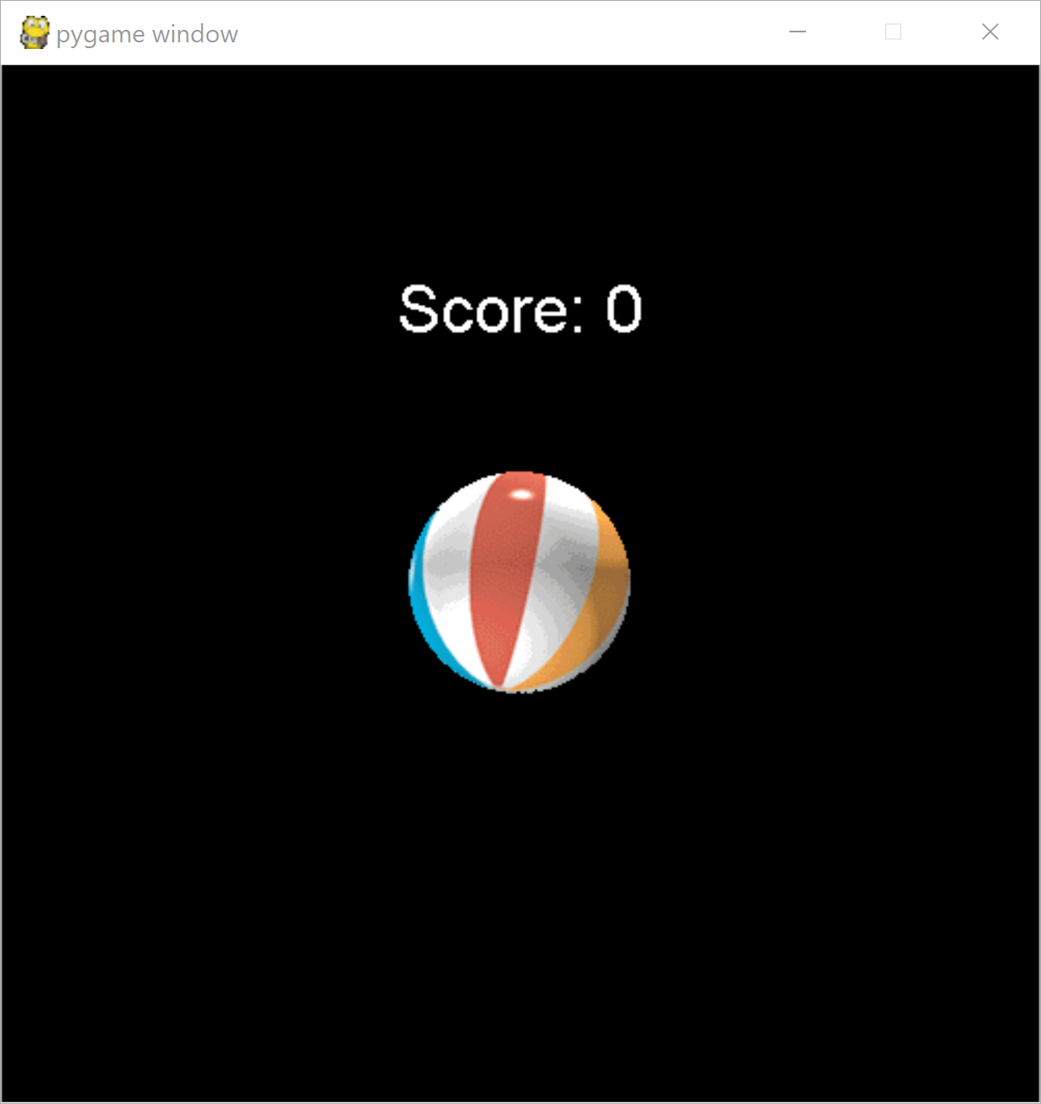
Pygame Fonts
You should also set up a score in text. The score itself can just be a variable, and the text can be displayed above the image.
Set up a font first; then render text based on that font. Then the text can just be displayed with blit.
This time, let's specifically provide a coordinate pair with the location where we want the text to show up.
import pygame
pygame.init()
...
score = 0
white = pygame.Color(255, 255, 255)
font = pygame.font.SysFont("Arial", 32)
score_text = font.render("Score: " + str(score),
False, white)
while playing:
...
screen.fill(black)
screen.blit(icon, icon_rect)
screen.blit(score_text, [250 –
score_text.get_width() / 2, 100])
pygame.display.flip()
exit()

Slide 78
Pygame Collisions
Now we need to detect whether the image has been clicked on. The easiest way to do this is with collision detection.
Luckily, this is something that Pygame does really well! If you can capture where the user clicked on the screen, you can easily detect whether that pixel location collided with the image's icon.
To capture the clicked location, check for a new event type - a MouseButtonUp event. This will happen when the user has clicked on the screen and releases the button. When this happens, use the pos property of the event to get the mouse's current position.
Then call the method collidepoint on the image's rectangle and the point to see if they collide. If they do, update the score.
import pygame
pygame.init()
...
while playing:
for event in pygame.event.get():
if event.type == pygame.QUIT:
playing = False
elif event.type == pygame.MOUSEBUTTONUP:
if icon_rect.collidepoint(event.pos):
score += 1
...

Slide 79
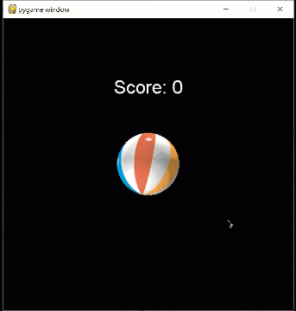
Pygame Collisions
This is a good start, but it isn't enough by itself. We've updated the score, but we haven't updated the score text, so the change will never be registered on the screen.
You need to update the score_text variable to show the new score. For now, let's just copy and paste the line we used before. In the future, though, this would be better placed in a helper function.
And with that, the game works!
import pygame
pygame.init()
...
while playing:
for event in pygame.event.get():
if event.type == pygame.QUIT:
playing = False
elif event.type == pygame.MOUSEBUTTONUP:
if icon_rect.collidepoint(event.pos):
score += 1
score_text = font.render("Score: " +
str(score), False,
white)
...

Slide 80
Game Programming
This approach works, and it's fine if you're not planning to develop the game any further, but if you do plan to extend what the game can do, you should restructure the code a bit.
Object-oriented approaches are really useful for game design. Putting all your major game components into classes helps to organize your code and makes it much easier to manage the core game loop.
This kind of approach also makes it easier to add new features, as it's more clear where the code should go.
Try revisiting this idea after we cover OOP!

Slide 81
Vpython
Vpython is a nice library for creating and interacting with 3D graphics. It's mainly aimed towards scientific simulations, though; for more game-like 3D graphcs, you'll probably want to use a game engine (like Unity, or Unreal).
Website: https://vpython.org/
pip install vpython

Slide 82
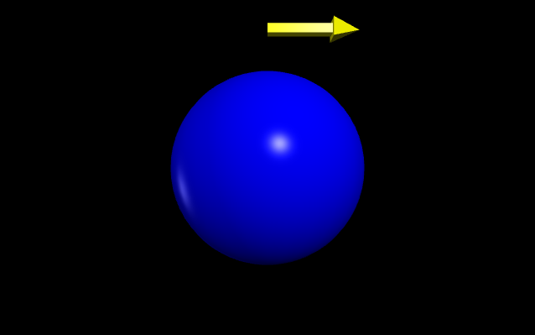
Vpython 3D Objects
Programming in Vpython is mostly similar to programming in Tkinter. The main difference is that you construct 3D objects like spheres and points instead of 2D shapes.
from vpython import *
ball = sphere(pos=vector(0, 0, 0),
radius=100, color=color.blue)
pointer = arrow(pos=vector(0, 150, 0),
axis=vector(100, 0, 0),
color=color.yellow)
When you run the script, it opens a browser window to render the graphics.

Slide 83
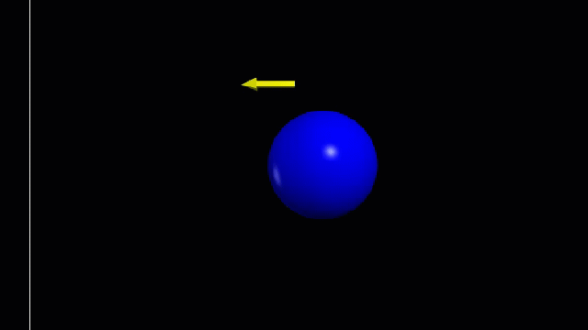
Vpython 3D Object Manipulation
You can then program in your own physics to interact with the 3D objects or make them move. Usually this is done by setting up an infinite while loop.
The rate function tells the while loop how long to wait between iterations. This makes it possible to actually see the animation move.
For example, by changing the vector position of the ball, we can make it move back and forth. We can even have it change directions by changing the delta movement.
Changing the axis of the arrow makes it point in the same direction as the ball is moving.
move = vector(10, 0, 0)
while True:
rate(100)
ball.pos = ball.pos + move
if ball.pos.x >= 300 or \
ball.pos.x <= -300:
move = vector(-move.x, 0, 0)
pointer.axis = -pointer.axis

