Slide 1
Lab 1: Introduction
User Interface Lab: GUI Lab
Aug. 28th, 2013

Slide 2
Lab Instructor
Kelly Rivers
krivers@andrew.cmu.edu
NSH 2602 2612
Office Hours
  Tuesday 4-5pm
  Thursday 11-12pm

Slide 3
Lab Coordinator
Anind Dey
anind@cs.cmu.edu
Office Hours
  By appointment

Slide 4
Introduction
Introduce yourself!
  Name, year, major
  What do you hope to learn from the lab?
Notes:
How many know HTML/XML?
Any actionscript or javascript coders?

Slide 5
Lab 1
Introduction
Basic lab info
Adobe flash/flex platform overview
“Hello world” walkthrough

Slide 6
Our platform: Flex 4.6
Platform for developing apps that run on:
  Desktop: Adobe AIR
  Web: Adobe Flash Player
Notes:
Flex is a highly productive, open source application framework for building and maintaining expressive web applications that deploy consistently on all major browsers, desktops, and devices. It provides a modern, standards-based language and programming model that supports common design patterns suitable for developers from many backgrounds

Slide 7
Why Flex?
Open source
GUI builder
Great development tools
Similar to HTML and javascript
Common platform

Slide 8
Why not Flex?
Flash doesn’t run on all platforms
  iDevices
Flash builder is usually not free
Notes:
Mobile devices

Slide 9
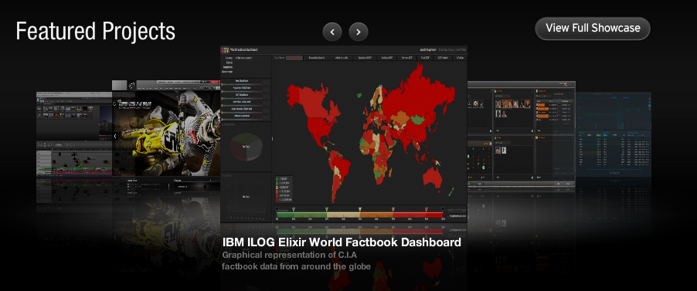
Sample Flex applications
http://www.adobe.com/devnet/flex/samples.edu.html

Slide 10






Authoring
File Format
Viewing
Flash Builder
Compilation
Interpretation
Flash Player (Web)
Flash Professional
.swf file
Adobe Air (Desktop)
Flash Catalyst

Slide 11
Authoring
File Format
Viewing
Flash Builder
Compilation
Interpretation
Flash Player (Web)
Flash Professional
.swf file
Adobe Air (Desktop)
Flash Catalyst

Slide 12
Flex framework
MXML (similar to HTML)
  Creating interface objects and layout
Actionscript (similar to javascript)
  Creating interactive behavior associated with objects on the interface

Slide 13

MXML:
<s:Button id=“myButton”
x = “132”
y = “91”
width = “162”
height = “66”
label=“Click Me!”
click=“doSomething()“
/>
actionScript:
private function doSomething():void{
if(myButton.getStyle("color") == 0x00000)
myButton.setStyle("color", 0xff0000);
}

Slide 14
MXML:
<s:Button id=“myButton”
x = “132”
y = “91”
width = “162”
height = “66”
label=“Click Me!”
click=“doSomething()“
/>
actionScript:
private function doSomething():void{
if(myButton.getStyle("color") == 0x00000)
myButton.setStyle("color", 0xff0000);
}

Slide 15

MXML:
<s:Button id=“myButton”
x = “132”
y = “91”
width = “162”
height = “66”
label=“Click Me!”
click=“doSomething()“
/>
actionScript:
private function doSomething():void{
if(myButton.getStyle("color") == 0x00000)
myButton.setStyle("color", 0xff0000);
}

Slide 16
Let’s write “Hello World”

Slide 17
Next week
Come to class with your laptop with Flash Builder 4.6 and Flash Player installed
  Flash Builder:
  http://www.adobe.com/devnet-apps/flex/free/
  Apply to the educational copy ASAP. Use the trial version for now.
Your “Hello World” program
  We will start from modifying the code you have.
Project 1 will be announced

Slide 18
Resources
ActionScript references
http://help.adobe.com/en_US/FlashPlatform/reference/actionscript/3/index.html
Tour de Flex
http://www.adobe.com/devnet/flex/tourdeflex.html
Course Website
http://www.krivers.net/pui-gui-13/

