Slide 1
Lab 10: Images and Skinning, Sound and Assets
User Interface Lab: GUI Lab
Oct. 30th, 2013

Slide 2
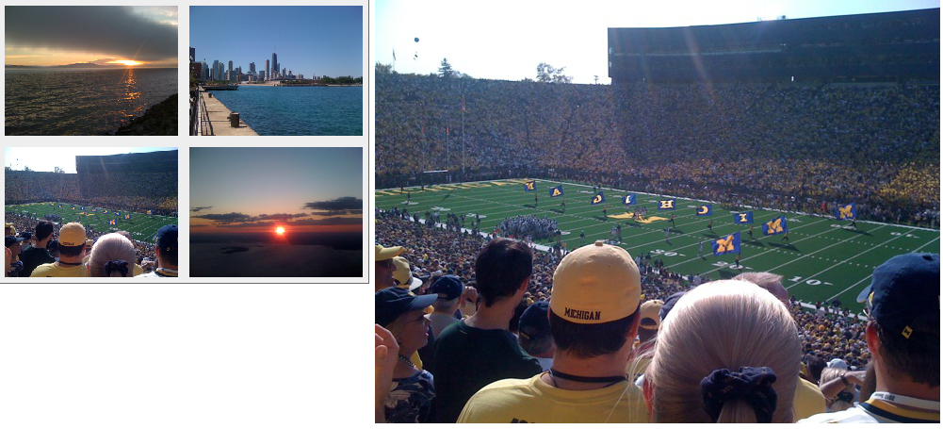
Lab 10 ICP
We are going to create a very simple photo browser
Your final project can’t just be like this…

Slide 3
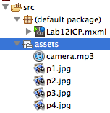
Lab 10 ICP
Create a Lab10ICP
Download Lab10_resources.zip from Blackboard
Create a new folder named “assets” under “src”
Drag the resource files into “assets”

Slide 4
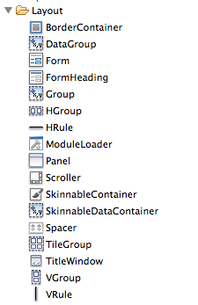
Create the layout
Go to the design view, look at the widgets in the layout folder. What can we use?
Go back to your UI design. Try to use a combination of layout widgets to construct your UI.

Slide 7
HGroup

Slide 8
HGroup

Slide 9
BorderContainer
HGroup

Slide 10
BorderContainer
HGroup
TileGroup

Slide 11
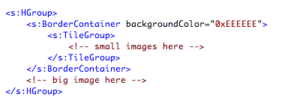
Create the layout

Slide 12
Use images in MXML

Slide 13
Adding gaps between the images

Slide 14
Assign source to big_photo
Big_photo should be the photo that is clicked
Give click event handlers to all small images
Pass the image in as a parameter
In the event handler, set big_photo’s source to be the clicked image’s source

Slide 15
Filters
You can apply filters to a component to modify its visual appearance
Common filters are DropShadowFilter, GlowFilter, and BlurFilter.
Other filters are in the spark.filters. Package
Filter can be apply directly to an object, or animated using AnimateFilter effect

Slide 16
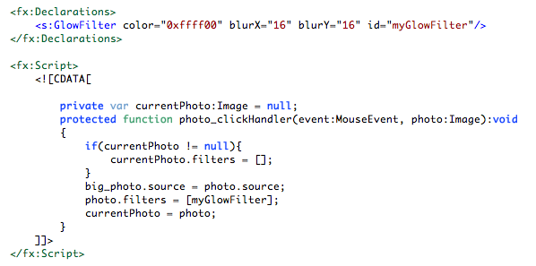
Filters

Slide 17
Filters

Slide 18
Animate Filters
Using <s:AnimateFilter>
Similar to <s:Animate>
First, declare the animation in fx:Declarations
Then, play the animation

Slide 19
Sound
Declare sound effect in fx:Declaration
Play the sound effect using id.play([this])

Slide 21
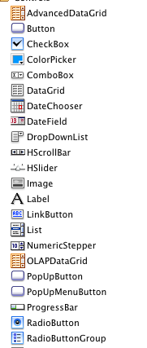
Skinning
Flex has many built-in UI components
Button, slider, check box, text input…
Reusing the components can save developers much time and effort
The behavior of the components is the same across apps, but their appearance can be very different

Slide 22
Skinning
The appearance of a component is decided by its default skin file
Behavior is defined in a separate file
We can customize the appearance by having our own skin file!

Slide 23
Skinning
Skin files are in MXML
All default skin files are stored in [your Flash Builder directory] -> sdks -> 4.6.0 -> frameworks -> projects -> spark -> src -> spark -> skins -> spark
We’ll create our customize skin file by modifying the default skin
Flash Builder makes this easier

Slide 24
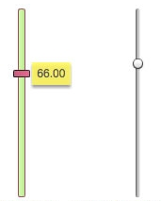
Lab 11 ICP
Create a new Flex Project “Lab11ICP”
Drag a VSlider in
Make it bigger so we can see the details

Slide 25
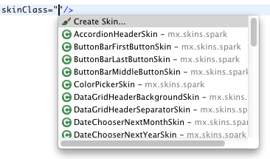
Assign a new skin to the slider
Using the “skinClass” attribute
Choose “Create skin” from the menu

Slide 26
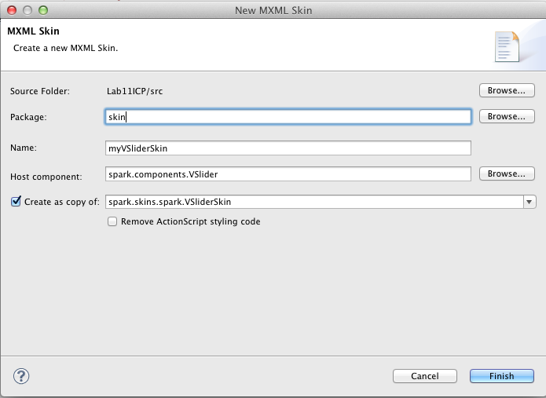

Slide 27
Look at the skin file
Can you tell from the skin file, what does a built-in slider consist of?

Slide 28
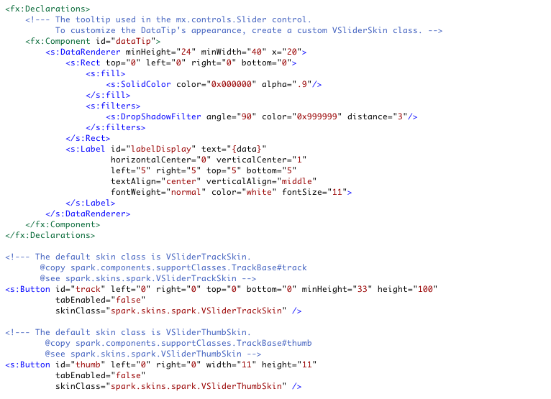

Slide 32
Give dataTip a custom look
Make it color of the rectangle be yellow (0xFFF46B)
Make the text color be gray (0x555555)
Now let’s take a look at the track

Slide 34
Give track a custom look
Track is actually a button
The appearance of track is defined in another skin file
Create a custom skin file in the same way as before

Slide 35
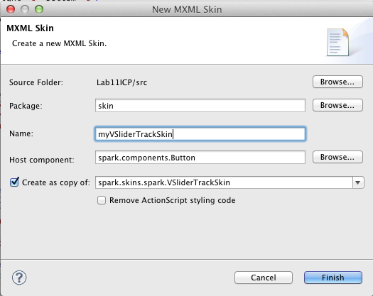

Slide 36
Give track a custom look
Track is consist by multiple rectangles
Try to read the comments to understand what each rectangle does
We’ll create our own look
If we are not sure what certain code does, leaving it there is better than deleting it…

Slide 37
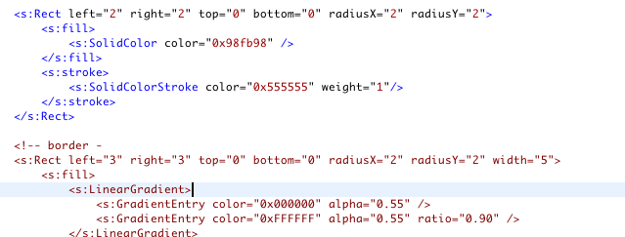

Slide 38
Give thumb a custom look
Create our own skin file as a copy of the default skin file in the same way

Slide 40
Give thumb a custom look
The appearance of the default thumb changes based on its current state (over, down)
Transition is taken care of in somewhere else.
Again, we’ll create our own look

Slide 41
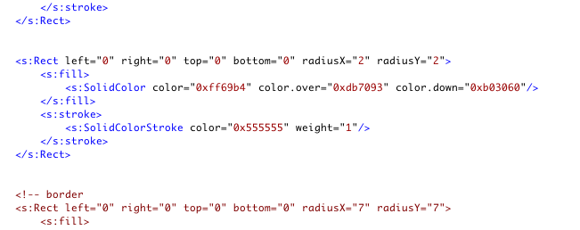

Slide 42
Fill the track background with image
Use <s:BitmapFill source=“@Embed(‘path’)” /> inside <s:fill>
Use the fillMode attribute based on your needs

Slide 43
Take a closer look at the skin file
<s:SparkSkin> is the root element for a skin file
In <fx:Metadata>, hostComponent refers to the Spark component/container you want to skin
Some actionscript styling inside <fx:Script fb:purpose="styling"> tag
You usually don’t need to touch it

