Slide 1
Lab 11: Animation
User Interface Lab: GUI Lab
Nov. 6th, 2013

Slide 2
Next week: Basic Demos due!
Should cover most basic functionality- really simple prototype

Slide 3
Review: States
0. Design your state machine
Declare states
Create the appearance of different states
Set up transition using event handlers
  So far, transitions have been immediate
  Color of the rectangle switches from red to blue
  What if we wanted to animate instead?

Slide 4
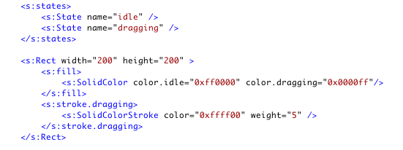
Suppose we want the color to transform smoothly from idle to dragging state

Slide 5
Steps
0. Design your state machine
Declare the transition we plan to add effects on
Declare the effects for the transition
Declare if these effects are sequential or parallel
Step 2 and 3 can switch order

Slide 6

Step 1: Declare the transition we plan to add effects on
Using <s:transitions> and <s:Transition>
  Similar to declaring states
  Use “*“ to select all states

Slide 7
Step 2: Declare the effects for the transition
Visual:
Animate
AnimateColor
AnimateFilter
AnimateShaderTransition
AnimateTransform
CrossFade
Fade
Move
Move3D
Resize
Rotate
Rotate3D
Scale
Scale3D
Wipe
Non-Visual:
Pause
SoundEffect
http://help.adobe.com/en_US/flex/using/WS4809A78C-9738-465d-B875-B0049C9B0ED4.html

Slide 8

Step 2: Declare the effects for the transition
Put the AnimateColor effect inside <s:Transition> tag
  Target is the color attribute of an target object
  Duration is in miliseconds

Slide 9
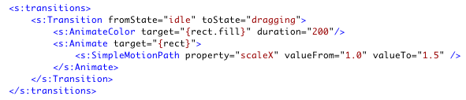
Step 2: Declare the effects for the transition
A more general animated effect is <s:Animate>
  Animate any properties of the target object
  Use SimpleMotionPath to define the name of the property and the property’s starting and ending value.

Slide 10
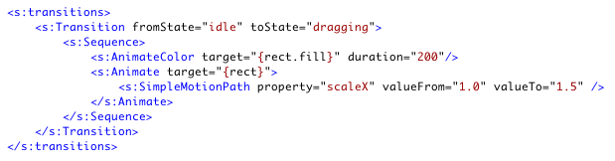
Step 3: Declare if these effects are sequential or parallel
If there are multiple effects, use <s:Sequence> or <s:Parallel> to wrap the effects

Slide 11
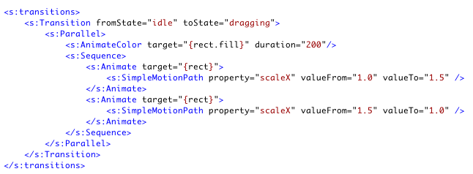
Step 3: Declare if these effects are sequential or parallel

Slide 12
Step 3: Declare if these effects are sequential or parallel
If there are multiple effects, use <s:Sequence> or <s:Parallel> to wrap the effects

Slide 13
Effects
We can also define effects in <fx:Declaration> and call the effects in event handlers
Suppose we want to drag the rectangle and when we release the mouse key, the rectangle goes back to the original location and rotates

Slide 14
Steps
0. Design your program
Declare if these effects are sequential or parallel
Declare the effects for the transition
Call the effects in event handler through Ids

Slide 15
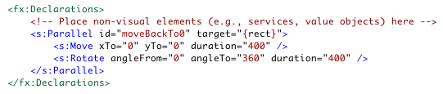
Step 1 & 2

Slide 16
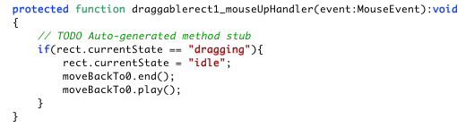
Step 3

