Slide 1
Lab 2: Interface Building
User Interface Lab: GUI Lab
Sep. 4th, 2012

Slide 2
Lab 2 goals
Interface builder intro
Widget Discovery
  Widget properties
  Layout
  Bindings
  MXML
  Callbacks
Project 1a: Getting Started

Slide 3
In-class Projects (ICP)
Not graded
Will go over material for upcoming labs

Slide 4
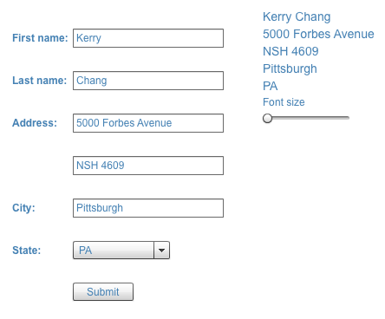
Lab 2 ICP goal

Slide 5
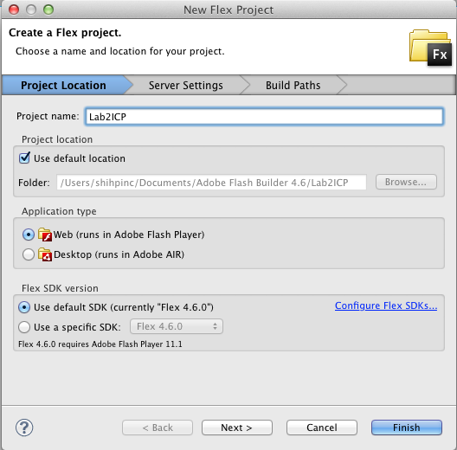
Create a new flex project
File -> New ->
Flex project
Name: Lab2ICP
Click “Finish”

Slide 6
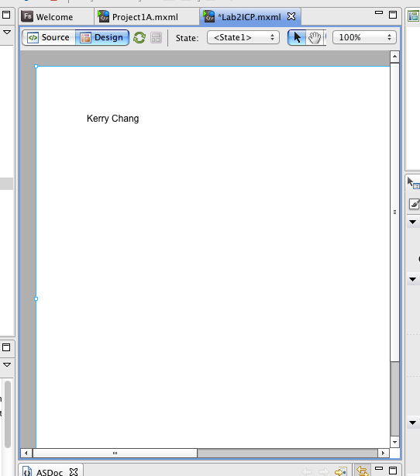
Create a label and enter your name
Switch to Design View
Drag in Label from Components
Double click Label, enter your name
Check the “source” tab, switch back to “design”

Slide 7
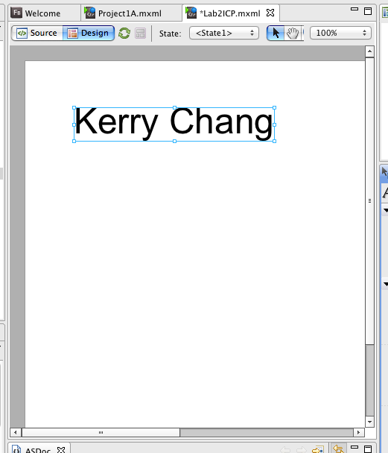
Change the font of your label
Click your label
Under properties tab, change text size

Slide 8
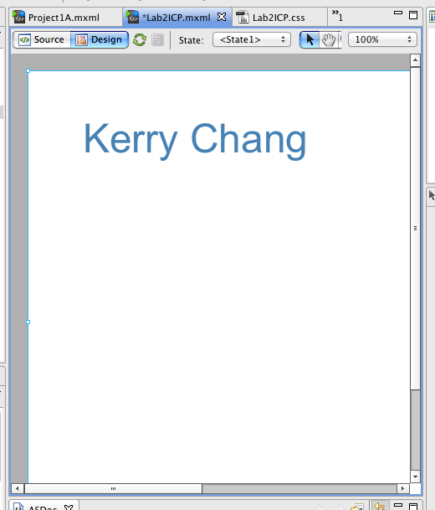
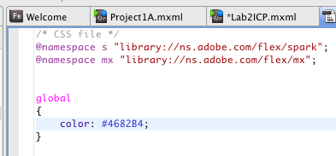
Experiment with CSS
Change the global application style text color
Look for the created css file
Notes:
Sorry, I was wrong :( Flex does have css
If you assign an id to the element, you can set the style using #id in the css file

Slide 9
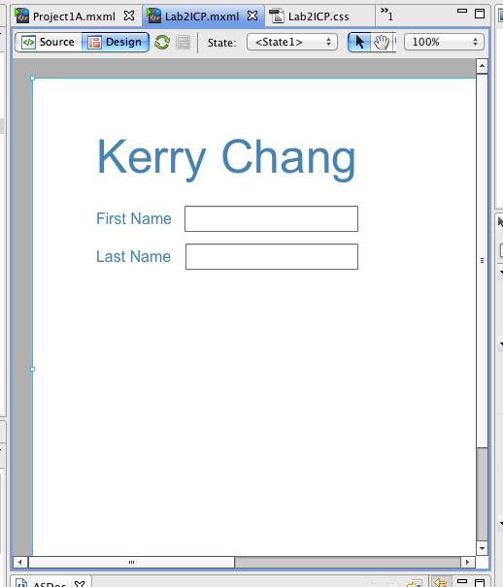
Add two labels and text inputs
First label:
“First Name”
Second label:
“Last Name”

Slide 10
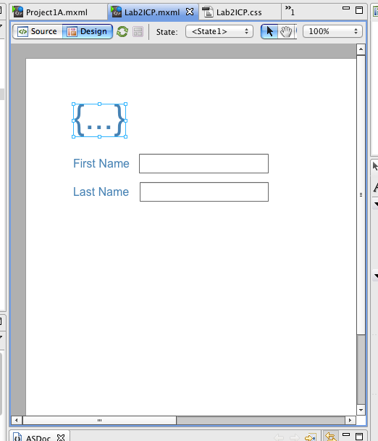
Bind name to text input values
Give TextInputs IDs:
first_name, last_name
Name label value:
{first_name.text}
Notes:
Id can only contains letters, numbers, _ and $. Id cannot contain space or other symbols
How to put both first and last name together in one label? Try it out

Slide 11
Bind the name label to the right edge
Bottom of the “property” tab, under “Size and position”
Constrain to right 10

Slide 12
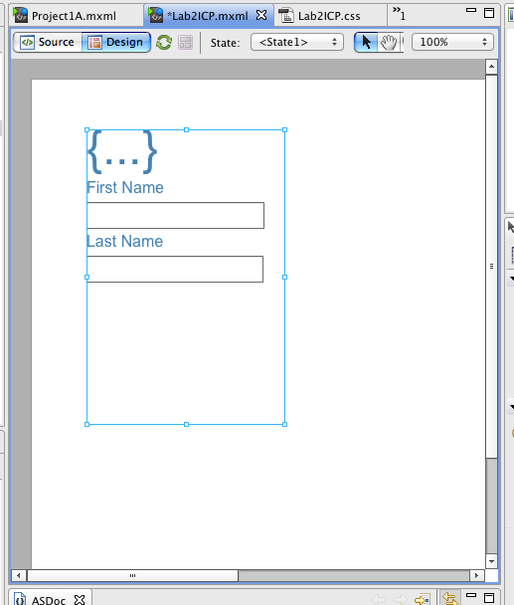
Add objects into a VGroup
Drag a VGroup in
Drag object into VGroup
Notes:
On the other hand, Hgroup layout objects horizontally

Slide 13
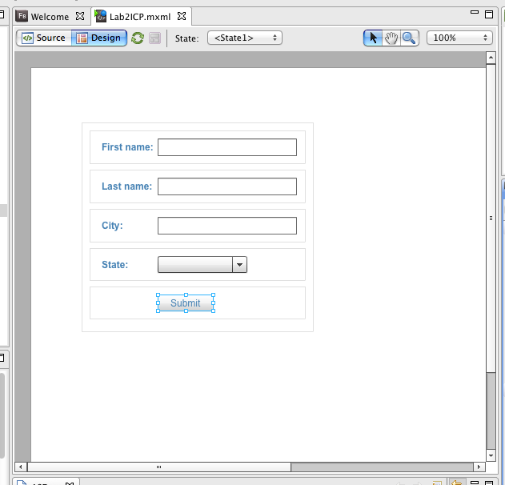
Create a form
Drag a Form in
Create FormItems in source view
Add:
  3 TextInputs (first_name, last_name. city)
  1 DropDownList (state)
  1 Button (submit)
Notes:
Sequence label??

Slide 14
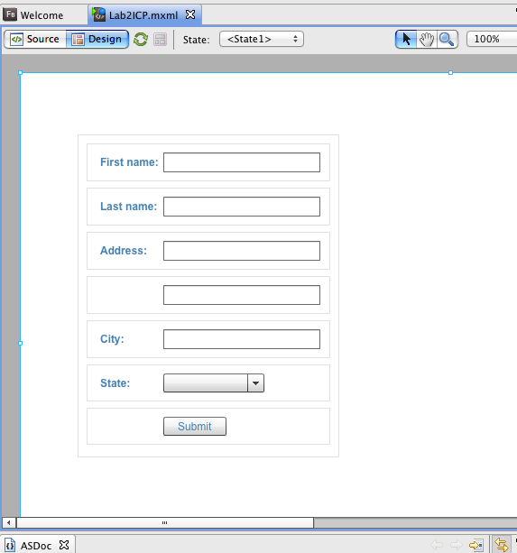
Create a Form
Drag a Form in
Create FormItems
Add:
  5 TextInputs (first_name, last_name. address (2), city)
  1 DropDownList (state)
  1 Button (submit)

Slide 15
Set up bindings for your form
{first_name.text +” “ + last_name.text}
{address1.text}
{address2.text}
{city.text}
{state.selectedItem}

Slide 16
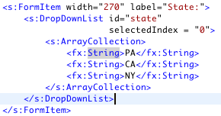
Populate the state list
In the source view
Run!
Notes:
Can change selectedIndex to -1 so it won’t have default value

Slide 17
Add comment to the MXML
<!-- comment -->

Slide 18
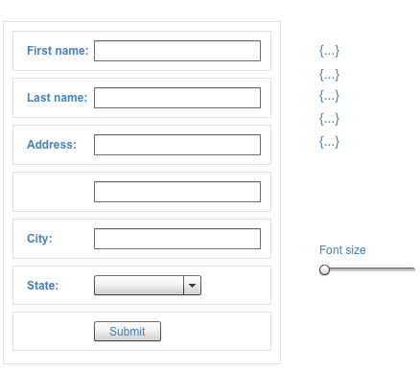
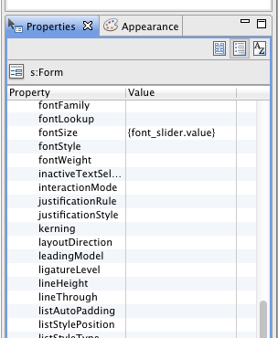
Add a slider, bind font size to slider value
In the source view
Run!
Notes:
Can change selectedIndex to -1 so it won’t have default value

Slide 19
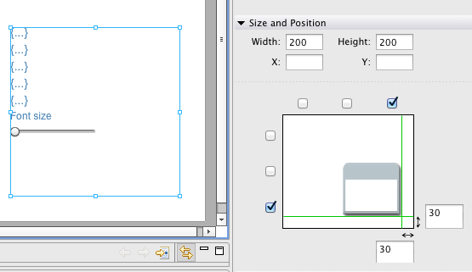
Bind the position of the form and label
Constrains vs. x, y coordinates
Notes:
Can change selectedIndex to -1 so it won’t have default value

Slide 20
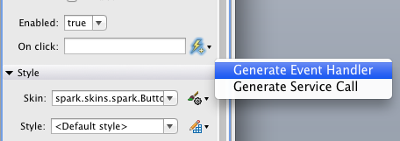

Pop up window on submit
Notes:
Can change selectedIndex to -1 so it won’t have default value

Slide 21
Next time: actionscript intro
Basic OOP and SE concepts
Project 1B
How time stamps work (usually)
How to trace/debug
As always, bring your laptop!

Slide 22
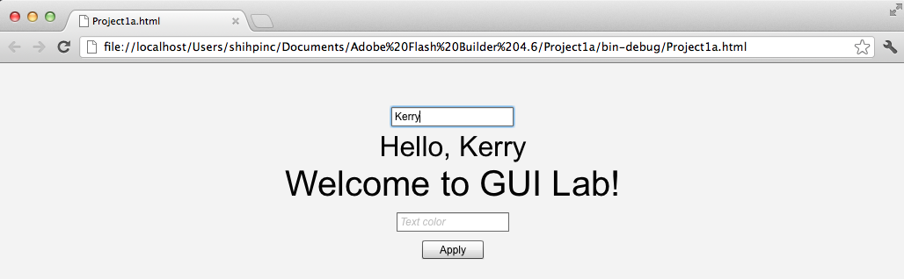
Project 1a
See Assignments page of course website
Turn in via FXP file
Due by 9:00am, 9/19 via email

