Slide 1
Lab 3: Actionscript
User Interface Lab: GUI Lab
Sep. 11th, 2012

Slide 2
Hw1a
Due now!

Slide 3
Project 1b
TBA
Uses actionscript (this lab)
Due by 9:00am, 9/25 (in two weeks)

Slide 4
Lab 3 goals
MXML: a more general perspective
Basic actionscript
  Variables
  Functions
  Conditions

Slide 5
MXML
Actionscript
Declarative language
Imperative language
Declare objects and layout between objects
  Other example: HTML
Good for layout declaration
Write imperative statement that get run top to bottom
  Other example: javascript
Good for interactivity
Example: Creating a rectangle that is 100 x 100
<s:Rect width=“100” height=“100” />
var rect1:Rectangle = new Rectangle;
rect1.width = 100;
rect1.height = 100;
this.contentGroup.addElement(rect1);

Slide 6
MXML
Actionscript
Declarative language
Imperative language
Declare objects and layout between objects
  Other example: HTML
Good for layout declaration
Write imperative statement that get run top to botttom
  Other example: javascript
Good for interactivity
Example: Creating a rectangle that is 100 x 100
<s:Rect width=“100” height=“100” />
var rect1:Rectangle = new Rectangle;
rect1.width = 100;
rect1.height = 100;
this.contentGroup.addElement(rect1);

Slide 7
MXML Components: Namespaces
mx – Halo
s – Spark (Halo + skinning)
fx – Language (programming)
map – Google Maps

Slide 8
MXML syntax
<s:Rect> </s:Rect>
Opening tag
Closing tag

Slide 9
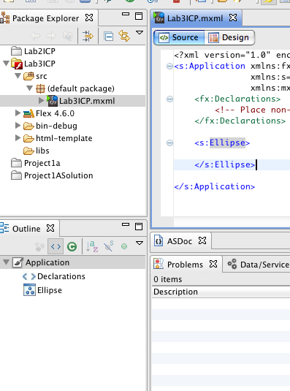
Declare an ellipse
In Source View
<s:Ellipse>
</s:Ellipse>
View the outline of your code

Slide 10
MXML syntax
<s:Rect width=“150”>
Opening tag
Attribute name
</s:Rect>
Attribute value
Closing tag

Slide 11
MXML syntax
<s:Rect width=“150” height=“150”>
Opening tag
Attribute
Attribute
</s:Rect>
Closing tag

Slide 12
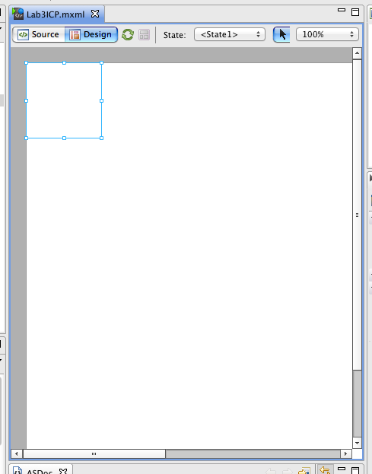
Set the width and height to 100
<s:Ellipse
width=“100”
height=“100”>
</s:Ellipse>

Slide 13
MXML syntax
Opening tag
Attribute
Attribute
<s:Rect width=“150” height=“150”>
<s:fill>
Child tag
<s:SolidColor color=“#FF0000” />
</s:fill>
</s:Rect>
Closing tag

Slide 14
Set the color of the ellipse
<s:Ellipse width=“100” height=“100”>
<s:fill>
<s:SolidColor color=“#FF0000” />
</s:fill>
</s:Ellipse>
Notes:
Run your program

Slide 15
MXML: Layouts
Containers
Organizers
Positioning
Notes:
(think HTML tables)

Slide 16
MSML
Actionscript
Declarative language
Imperative language
Declare objects and layout between objects
  Other example: HTML
Good for layout declaration
Write imperative statement that get run top to bottom
  Other example: javascript
Good for interactivity
Example: Creating a rectangle that is 100 x 100
<s:Rect width=“100” height=“100” />
var rect1:Rectangle = new Rectangle;
rect1.width = 100;
rect1.height = 100;
this.contentGroup.addElement(rect1);

Slide 17
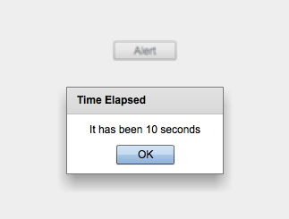

Slide 18
Tag
Don’t interpret as MXML
<fx:Script>
<![CDATA[
// code goes here
]]>
</s:Script>

Slide 19
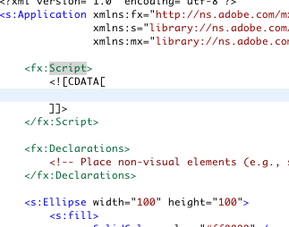
Declare a script in your application

Slide 20
Actionscript
public var myInt:int;
public var myStr:String= “hi”;
Access control
Name
Type
Value
Declaration

Slide 21
Declare a date object
Name: startTime
Type: Date
Initial value set to: new Date()

Slide 22
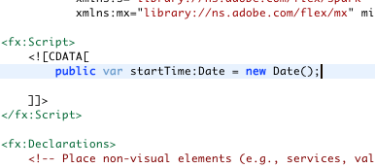
Declare a date object

Slide 23
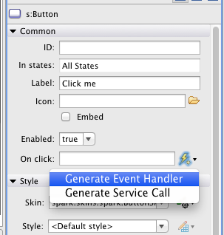
Add a button, generate event handler
Label: “Click me!”
Under “On click:”, click “Generate Event Handler”

Slide 24
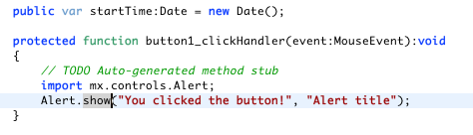
Pop up an alert on click
Test your program

Slide 25
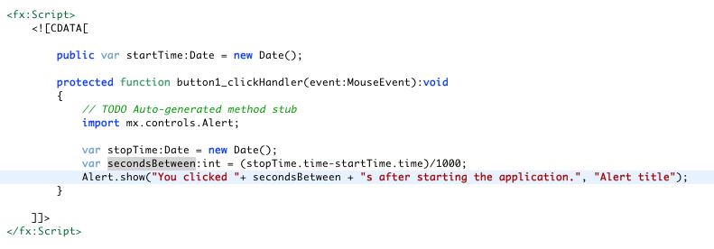
Show how many seconds since the app started
Test your program
Notes:
ADD ANOTHER SLIDE ABOUT WHEN USER CLICK OK THEN RENEW TIME

Slide 26
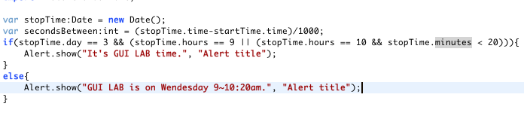
Show if the current time is the GUI lab time
Test your program

Slide 27
Where to Explore?
ActionScript references
http://help.adobe.com/en_US/FlashPlatform/reference/actionscript/3/index.html
Example Projects: Tour de Flex
http://www.adobe.com/devnet/flex/tourdeflex.html
Google!!

