Slide 1
Lab 6: event & input intro
User Interface Lab: GUI Lab
Oct. 2nd, 2013

Slide 2
Lab 6 goals
Hw1b review
Debugging Techniques
Events and Event handlers

Slide 3
Hw1b
Maybe a little too much?
Review Actionscript Syntax

Slide 4
Debugging
Official method: trace() with Flash Player in debugging mode

Slide 5
Debugging
Simple method: print it on the screen!

Slide 6
Events
Flex applications are event driven
  Outside of startup, every action is result of a trigger
Two even types:
  System events: component ready, timer done, etc.
  User events: mouse clicks, keyboard presses, etc.

Slide 7
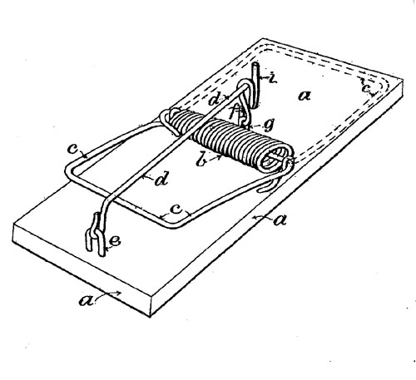
Event handlers
The pieces of code that get run after an event occurs
Think of them as spring loading your program

Slide 8
Event handlers
Written in actionscript
Takes in “event” parameter
  More information about the event
  Ex. position of the mouse, holding ctrl, etc.

Slide 9
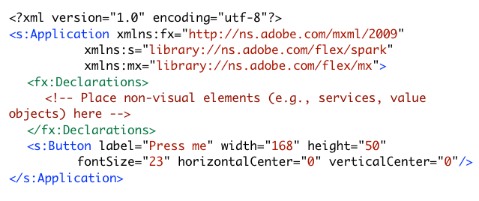
take this mxml application…
what does it look like?

Slide 10
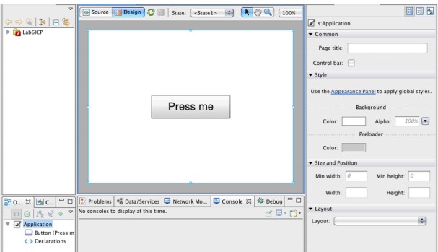

Slide 11
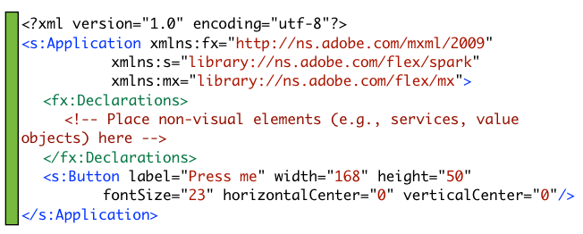
take this mxml application…
everything is run on startup

Slide 12
We want to pop up an alert when pressed…

Slide 13
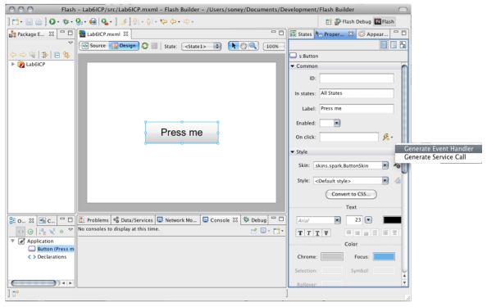
select button -> “generate event handler” does this for you

Slide 14
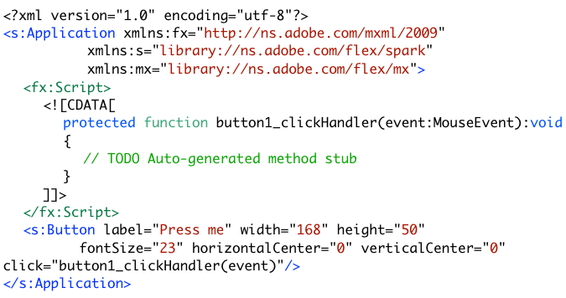
…after generating the event handler
where is the event handler here?

Slide 15
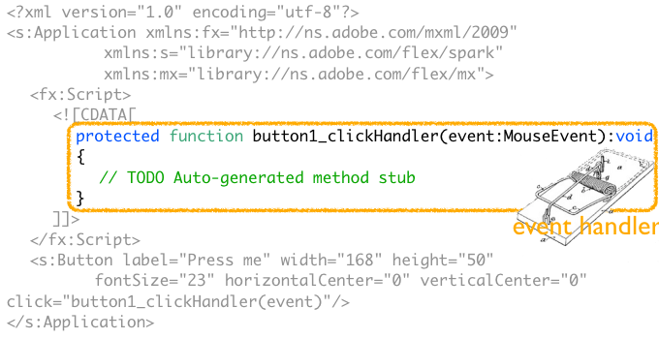
Event handler will get run only when button is pressed

Slide 16
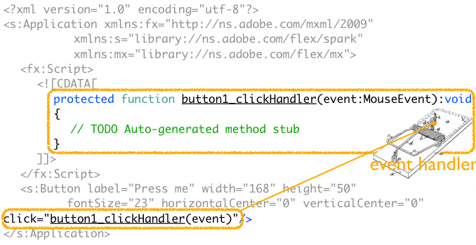
Event handler will get run only when button is pressed

Slide 17
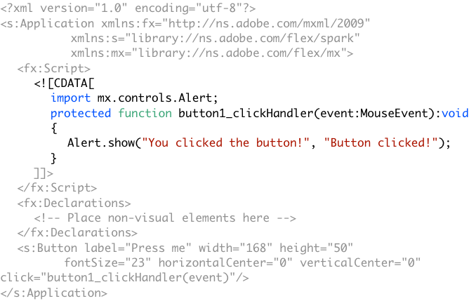
Showing an alert when the button is pressed

Slide 18
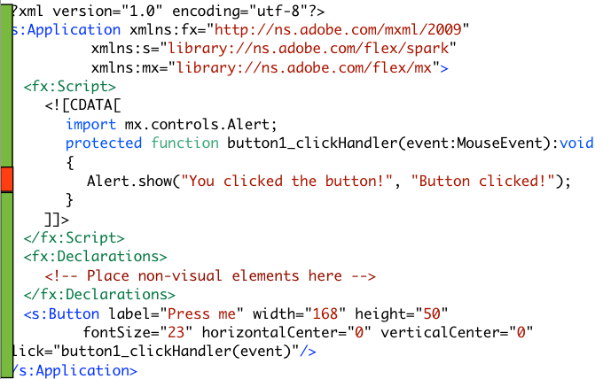
Green stuffs: run when application starts
Orange stuffs: run when the button is pressed

Slide 19
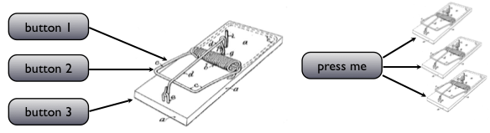
Event handlers
An event handler may handle events from multiple objects.
An object might distribute events to multiple event handlers.

Slide 20
In-class project
Create a new Flex project named “Lab6ICP”
Create a VGroup
Put a button in Vgroup
  Label: Button 1
  Id: myButton1
Put a label in Vgroup
  Doesn’t have any text in it
  Id: myLabel

Slide 21
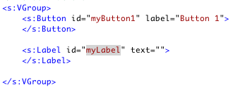

Slide 22

Create a click event handler for the button
Go back to source, take a look at the event handler
  The parameter passed in is called “event” that has a type “MouseEvent”
  What attribute does this event object have?
  Explore using the autocomplete menu (event. …)

Slide 23
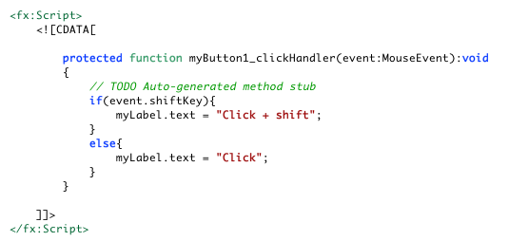
Use event parameter to see if shift key is pressed when button is clicked
Run and see the result

Slide 24
Create another button and let it use the same click event handler
Put a new button in VGroup between Button 1 and the label
  Label: Button 2
  Id: myButton2
Add an click event handler to the button in MXML
How do I know which button is clicked?

Slide 25
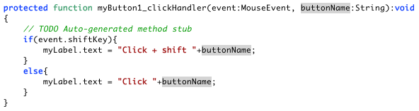
Add a parameter to the event handler to identify which button is clicked
Event handler is just a function that gets called when a specific event happens and takes that event as a parameter. It can be edited like any other functions.

Slide 26
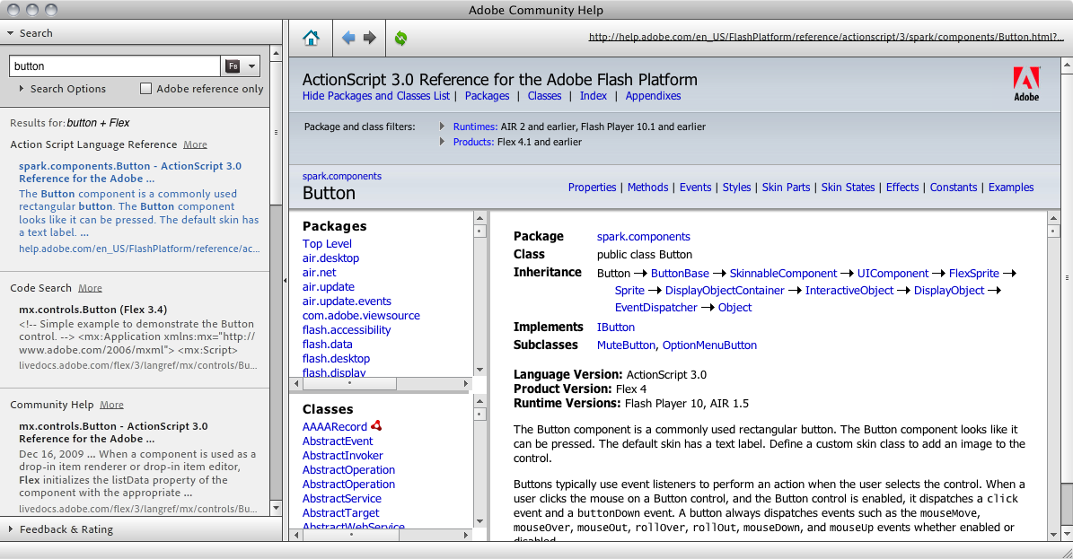
Things to note
Objects may have different event types
  What event does a button object have?

Slide 27
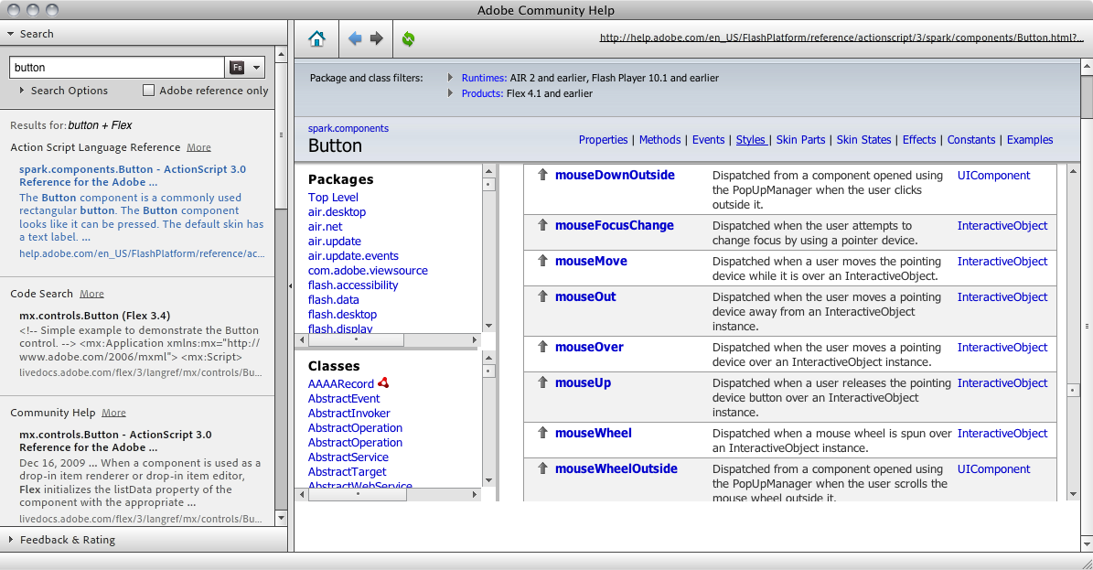
Things to note
Event -> Show inherited Events

Slide 28
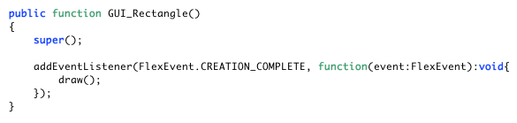
Event handler in Lab5ICP
Add an event handler to an object in actionscript
Lab 5 ICP

Slide 29
Name & type of the parameter(s) passed in
Access control
Declaration
Name
Return type
public function myFunction(x:int):int{
return x+1;
}

Slide 30
Name & type of the parameter(s) passed in
Access control
Declaration
Name
Return type
public function myFunction(x:int):int{
return x+1;
}

Slide 31
Make your GUI_rectangle interactive
Open Lab5ICP or download the solution from Blackborad
Suppose we want the rectangle to change its color when the user hovers the mouse on it, and pop up an alert box when the user clicks it, what event handler should we add to the rectangle?
  GUI_rectangle extends UIComponent

Slide 32
Make your GUI_rectangle interactive
Add three event handlers in the constructor
  MouseEvent.CLICK: pops up an alert saying “Click!”
  MouseEvent.MOUSE_OVER: draw a gray rectangle
  MouseEvent.MOUSE_OUT: draw a black rectangle

Slide 33
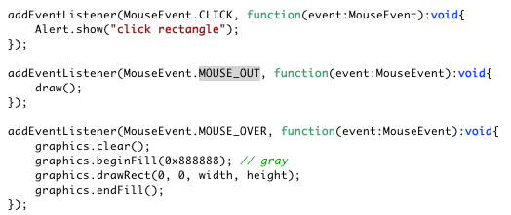

Slide 34
(if we have time) Review
Right now the initial color and hover color are set in the class file
  The blueprint already decides the color of the shape
What if I want to have many rectangles in my interface, each have different colors?
  Let the color becomes a public attribute that can be accessed and changed in MXML (during instantiation)
  Solution on Blackboard (Lab5ICP_solution-Oct3)

Slide 35
Next time: more on event & input

