Slide 1
Lab 8: States and Transitions
User Interface Lab: GUI Lab
Oct. 16th, 2013

Slide 2
Flash Builder Expiring!
Flash Developer for Windows
Eclipse for Macs
Website will update with fxp/zip options
Make sure to read instructions if using Eclipse!

Slide 3
Hw2 Updated
Due next Wednesday
Added in states & transitions- making the Easy Button clickable.

Slide 4
Project Proposal
Also due next Wednesday!
Main goal: communicate your project idea
  Preliminary scheduling/outlining
  Iterable!
Extra office hours at request

Slide 5
Lab 8 goals
States
Transitions

Slide 6
default
hover
pressed
We’ve learned how to change the look of an UI component based on user’s actions using event handlers

Slide 7
States
Different looks of an UI component can be considered as different states of the component
The component goes from one state to another based on different events
default
hover
pressed

Slide 8
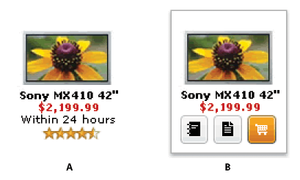
Using states in Flex
UI components
  E.g., buttons
  MXML component file
The whole application
  E.g., the application goes from a “login” state to a “welcome” state
  MXML application file

Slide 9
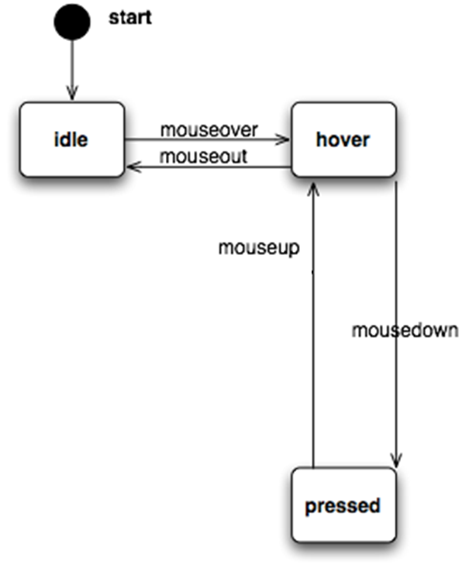
State machine diagram
Solid circles: start/end point
Rectangles: states
Arrows: transitions (directions, conditions)

Slide 10
idle
hover
pressed

Slide 11
State machine diagram
States make it easier to conceptualize different sets of appearance and behaviors
  A good practice is to draw the design before you start to write code
  The diagram could later be used to explain your code to other people

Slide 12
Steps
0. Design your state machine
Define states
Create the appearance of different states
Set up transition using event handlers

Slide 13
Step 0.
idle
hover
pressed

Slide 14

Step 1: Define states
Define three states for the MXML component: idle, hover, pressed
idle
hover
pressed

Slide 15
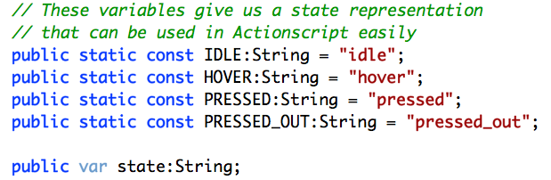
Alternative State Definition

Slide 16
Step 2: Create the appearance of different states
Text shows the name of the current state
Background color: 0xdcdcdc, 0xe6e6fa, 0x8b8989
Use attribute.state=“…” to assign values in different states
  E.g., text.idle=“idle”
idle
hover
pressed

Slide 17
Alternative Appearance Setting
protected function draw():void {
  switch (state) {
  IDLE : {set color for IDLE}; break;
  …
  }
}

Slide 18
Step 3: Set up transitions using event handlers
Based on the diagram, what event should we handle?
  mouseover, mouseout, mouseup, mousedown
  Create these four event handlers

Slide 19
Step 3: Set up transition using event handlers
The state of the component can be accessed in currentState
Set initial state to be idle
Set the rest of the transition based on the diagram

Slide 20

Step 3: Set up transition using event handlers
idle
hover
pressed

Slide 21
idle
hover
pressed

Slide 22
idle
hover
pressed
mouseout

Slide 23
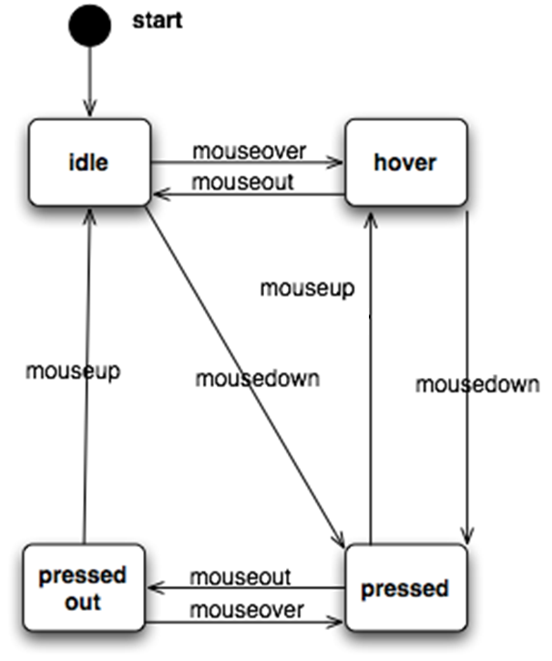
idle
hover
pressed
pressedout
(application)

Slide 24
idle
hover
pressed

Slide 25
View states for Application
Application can go from one view to another based on user’s actions
Let’s create a simple login interface
  What is your state diagram?

Slide 26
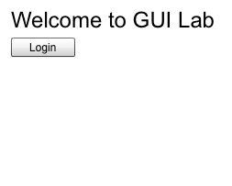
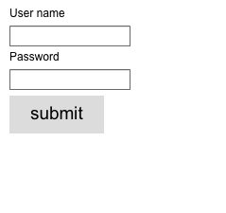
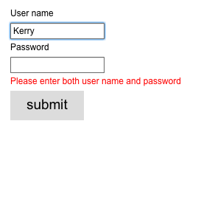
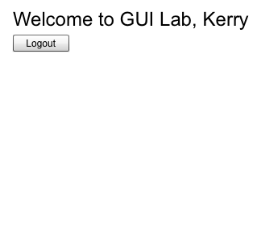
Login button
Is clicked
Submit button
Is clicked but
user name/password is missing
Logout button
Is clicked
Submit button is clicked and both user name & password are entered

Slide 27
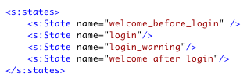
Step 1: Define states
Define four states

Slide 28
Step 2: Create the appearance of different states
Utilize the IDE!
  Design view states pane
  Code view state selection
Use includeIn/excludeIn attribute to include/exclude a component in a state
  Avoid redundant code
  attribute.state still works!

Slide 29
Step 3: Set up transition using event handlers
Based on the diagram
Change the value of a userName variable based on the current state

Slide 30
Other State Diagram Examples
Another common actions in an interactive UI – dragging.
Moves an item or changes the size of an item

Slide 31
Step 0.
Start

Slide 32
Step 0.
Start
Idle
Dragging

Slide 33
Step 0.
Start
Idle
mousedown
Dragging
mouseup
mousemove

Slide 34
Next time: Code Organization
Very helpful for designing and organizing projects!

