Slide 1
Lab 9: Code Organization
User Interface Lab: GUI Lab
October 23rd, 2013

Slide 2
Class Announcements
Hw2- Finished!
Project Proposals- Submitted!
  Feedback by Saturday
Project Design Documents- due next week

Slide 3
Code organization
Making your code modular
Allows for:
  Code reuse
  Clearer and cleaner code
  Separation of concerns

Slide 4
Code organization
Separating your project into modules
  actionscript classes, MXML components
Should be able to swap out one module for another
Key: figuring out which module to write

Slide 5
Organization of Modules
Object-oriented programming
  Think of classes as real-world objects
MXML vs. Actionscript
  MXML components are items on the screen
  Actionscript files define interactivity in the app

Slide 6

Example: Angry Birds

Slide 7
Class diagrams
Describe the design of the modules (classes) and the dependencies between them
Very useful for communicating your program design to others
  Also helps you finalize the structure of your program

Slide 8
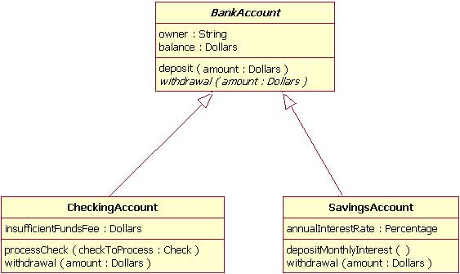

Slide 9
Class diagram
Rectangles represent classes
  Important variables, functions
  Some class diagrams use plus and minus sign to represent accessibility
Arrow lines represent inheritance
  CheckingAccount extends BankAccount
Dash arrow lines represent implementation
  GUI_Smiley implements GUI_Shape

Slide 10

Design pattern
Reusable software strategy that can help solve common problems in software design
Not a solution, but a guide
  A description or template for how to solve a problem
Many design pattern help create modular code

Slide 11
MVC (model-view-controller)
Model: store the data & state and let components know when something changes
View: show the Model’s data to user in a visual form (UI components on the screen)
Controller: interpret the user actions on the view and update model (usually an event handler)
Separate application logic from the interface

Slide 12

controller
update model
based on user input
select view
user input
model
data & state changes
view
http://cookbooks.adobe.com/post_Simple_MVC_for_Flex_and_AIR-16199.html

Slide 13
MXML vs. actionscript
When do you write an actionscript class versus an MXML component?
MXML for visual components
Actionscript for non-visual components

